Slide 1
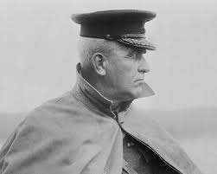
Sir Sam Hughes
World War 1

Slide 2
The Good
Minister of Militia and Defence (1911-1916)
Credited with initial massive recruitment drive
Credited with fast mobilization of troops

Slide 3
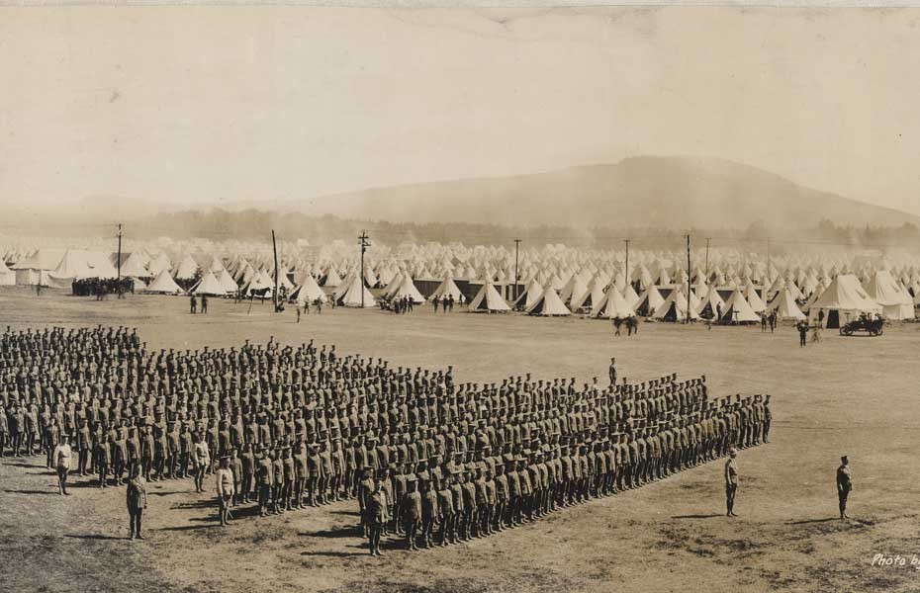
Valcartier, Quebec Training Center

Slide 4
The Bad
Valcartier was a new training camp, established quickly
Ross rifle was ineffective in the field
The Canadian Uniforms (including boots) were of poor quality

Slide 5
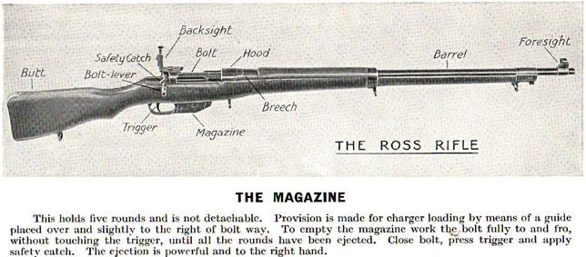
Ross Rifle

Slide 6
The Ugly
A war profiteer is any person or organization that profits from warfare or by selling weapons and other goods to parties at war. The term has strong, negative connotations.

Slide 7
The Ugly
Corruption – Shell Committee
Patronage – Canadian-made Ross Rifle
Forced Resignation in 1916

Slide 8
One more term
Imperial Munitions Board
After the Shell Committee was dissolved the IMB was established in 1915
Answered to Britain, run by a Canadian

