Slide 1
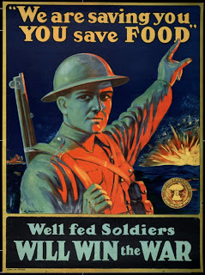
Total War
All (or most) resources of a country are used for the war effort

Slide 2
Factories
Civilian industries mobilized to manufacture artillery
Thousands of women were hired to work in the factories
IMB hired 30,000 women

Slide 3
Changing Roles
Women’s new jobs were considered temporary
Many women would no longer be satisfied to play only their traditional roles as wives, mothers, and domestic workers.

Slide 7
S.O.S and “Farmerettes”
Soldiers Of the Soil
Teen boys and girls recruited by the Food Board to work on farms
Terms of 3 months or more

Slide 8
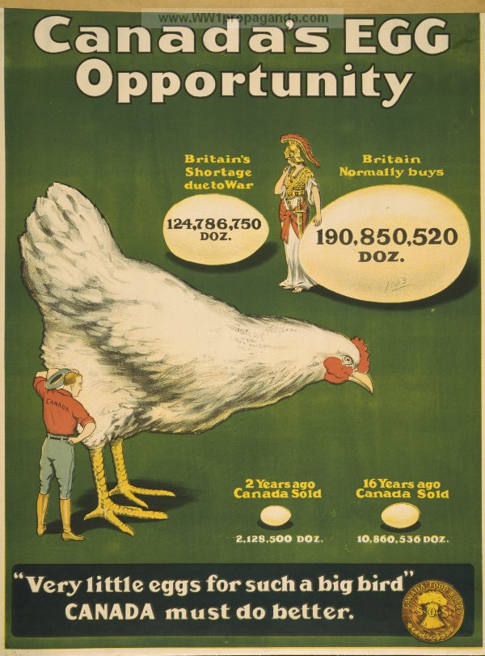

Slide 9
Rationing
Canadians were required to ration their consumption of food (and other things like gas) in order to “feed the troops” and help the war effort

Slide 10
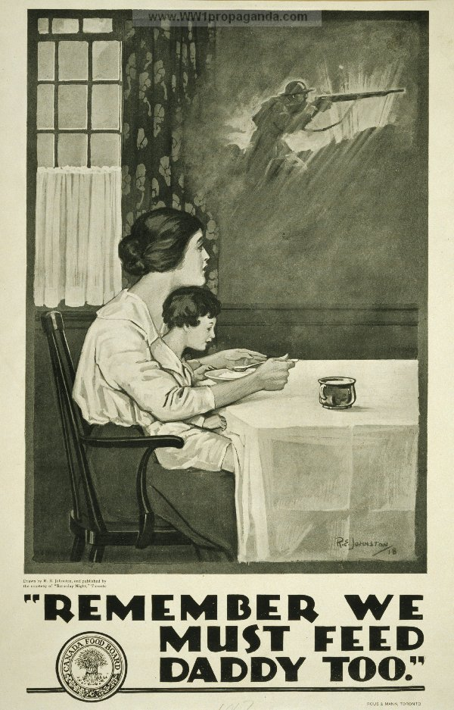
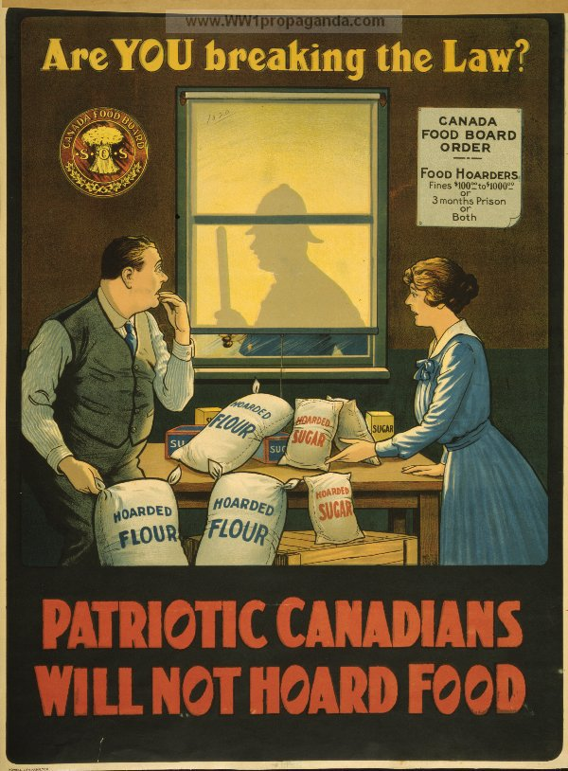

Slide 12
The Cost of War
War is expensive
Borrowed from Britain first and then the United States
Money raised with war bonds (victory bonds)
Money raised with income tax (1917)

Slide 13
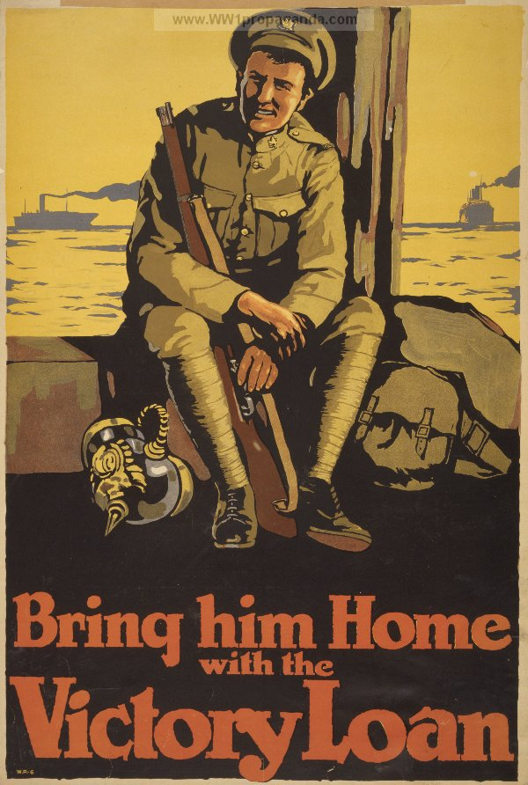
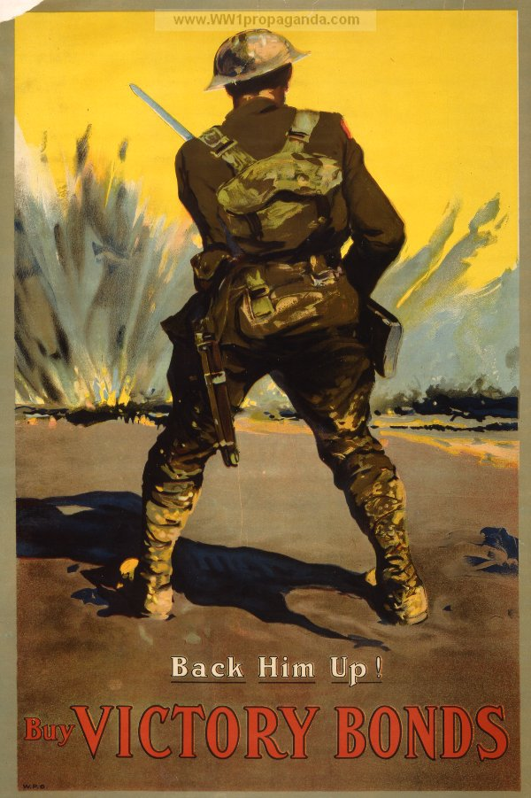

Slide 14
