Slide 1
The War is On
Canada declares war on September 10, 1939

Slide 2
Canadians started lining up at recruiting offices as soon as war was declared.
Some to have a steady job
Some seeking adventure
Some believed it was simply the right thing to do

Slide 3
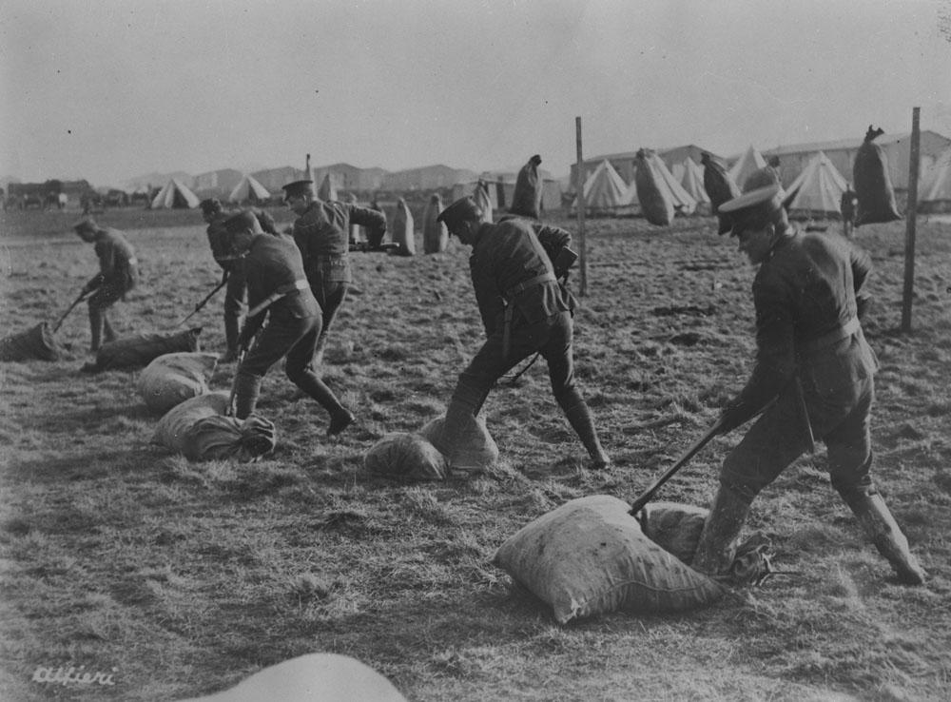
Not Ready….
First Canadian troops arrive in Britain end of December 1939
“Green recruits”
Unfinished barracks and short of equipment
So Canadians spent the next months training… sometimes with wooden bullets!

Slide 4
Not Ready
Allies as a whole were not ready
So very little fighting was happening
This is the period called the “The Phoney War”
The allies were scrambling

Slide 5
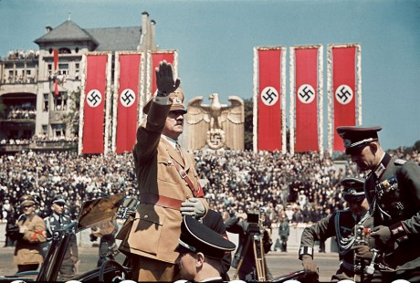
Advantage Nazi
German forces continued their advance throughout Europe
Blitzkrieg – “Lightning War”

Slide 6
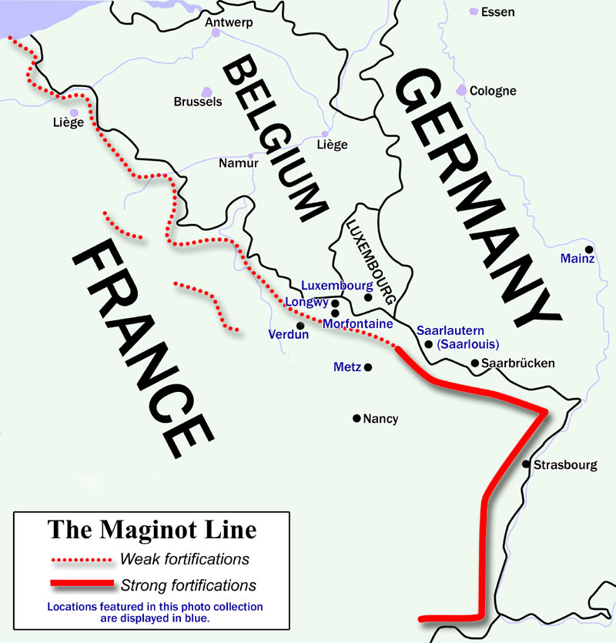
The Maginot Line
France had prepared for another World War One
Concrete defenses built between France and Germany

Slide 7
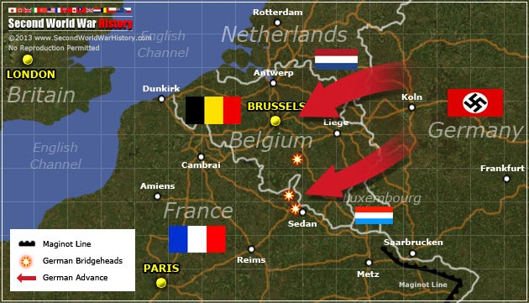
German forces went around the line through Belgium
Allied defences collapsed
Pinned down at Dunkirk

Slide 8
VIDEO – Evacuation of Dunkirk
https://www.youtube.com/watch?v=F47B4O5mrCo

Slide 9
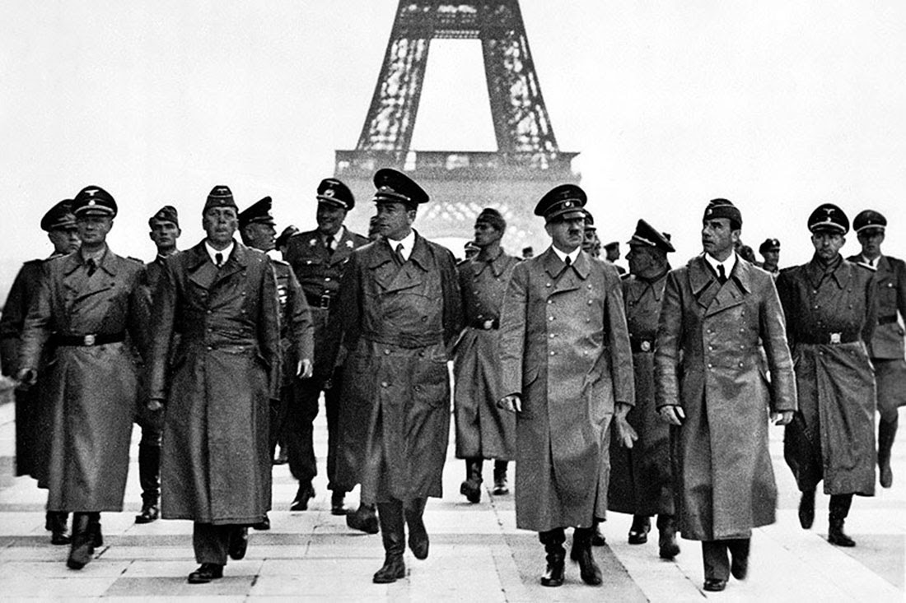
France Surrenders
June 25, 1940
German forces occupy northern and western France
Vichy France – Puppet Government in the south

Slide 10
Battle of Britain
https://www.youtube.com/watch?v=euRlmTHpSCI

Slide 11
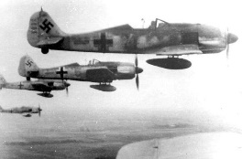
Battle of Britain
Luftwaffe had 2500 planes compared to RAF 1200
RAF had superior radar

Slide 12
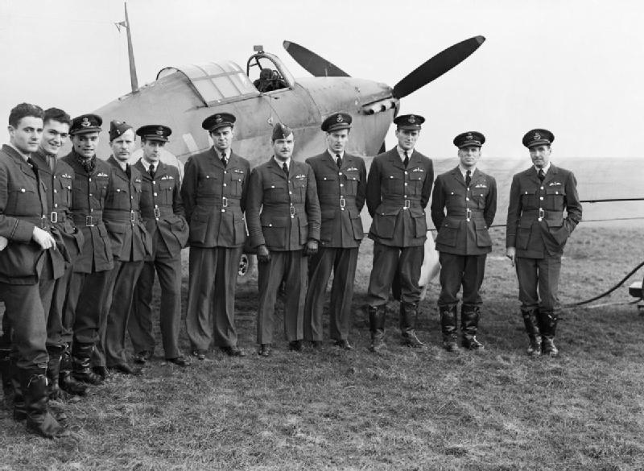
Canada and the Battle of Britain
100 Canadian pilots flew in fighter operations
200 more flew bombing raids
Even more served as ground crew

Slide 13
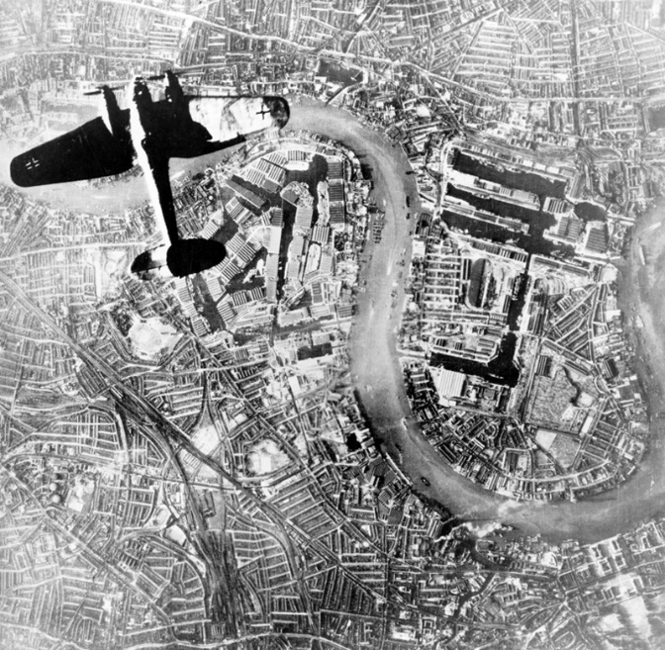
Retaliation
Luftwaffe accidently bomb London (instead of military base targets)
RAF bombed Berlin in response
Luftwaffe starts bombing London intentionally

Slide 14
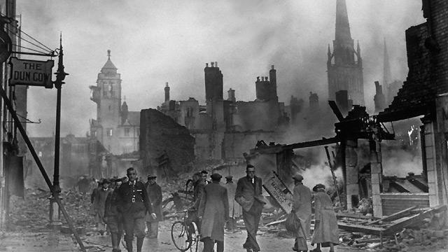
The Blitz
Reducing parts of the city to rubble
Killing as many as 43,000 people

Slide 15
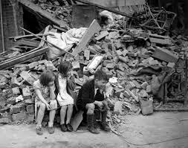
Breathing Space
Because of the shift in targets the RAF was able to regroup, rebuild, and gather reinforcements
By May 1941 Luftwaffe was losing ground and the Battle of Britain petered out

Slide 16
Winston Churchill
https://www.youtube.com/watch?v=Ynq9Aikz36Q

