Slide 1
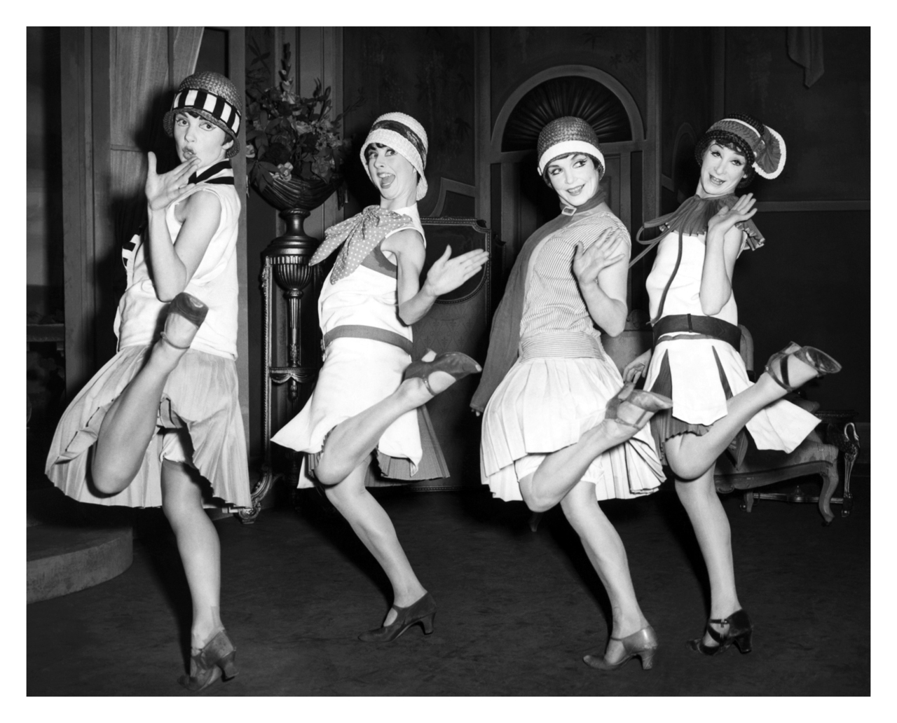
The Roaring Twenties

Slide 2
What do you think?
What is a person?
What is meant by Americanization?

Slide 3
Investing in canada
1922 – US leading investor in Canada
Before – Brits invested in Canadian owned
Now – US invests in American owned and controlled BRANCH PLANTS

Slide 4
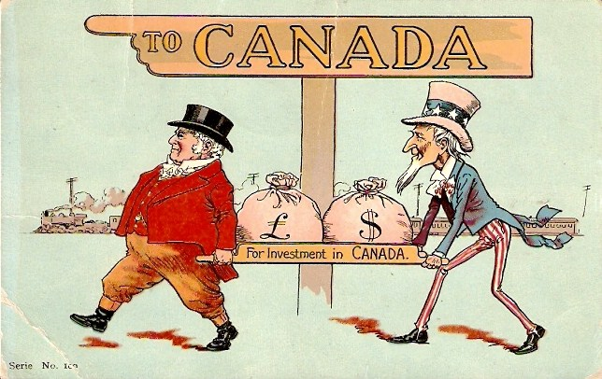
Investing in canada
Helps – economic growth
Hurts – Canadian sovereignty

Slide 5
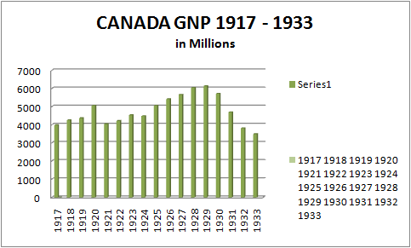
Optimism
Stock investment and growth unprecedented
1921-1929 Canadian stock prices tripled

Slide 6
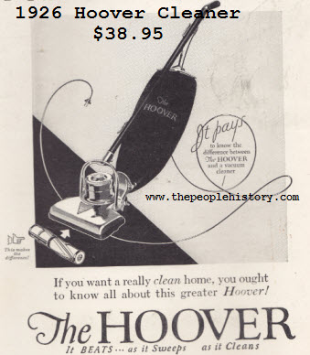
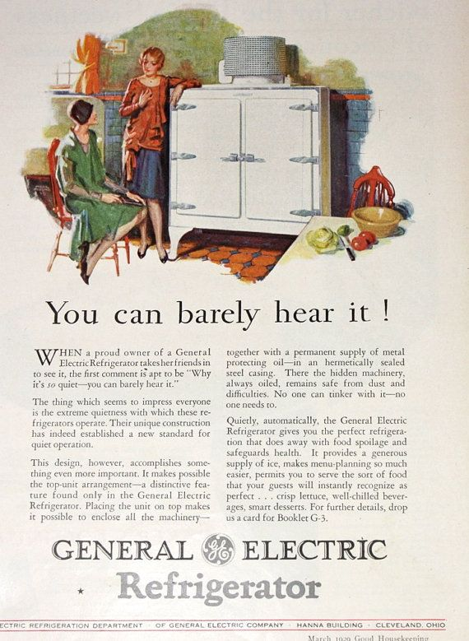
People on the move
Electricity and electric appliances increase
People move to cities for manufacturing jobs

Slide 7
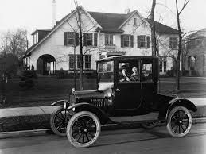
People on the move
Cars mass-produced making them cheaper
Tourism increased
Average person had access to a lifestyle previously restricted to the wealthy

Slide 8
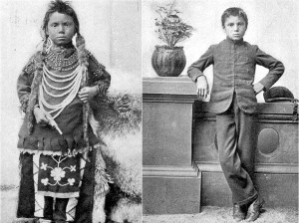
Who was excluded
First Nations, Immigrants, and African Canadians
Racism, poverty, and lack of political representation

Slide 9
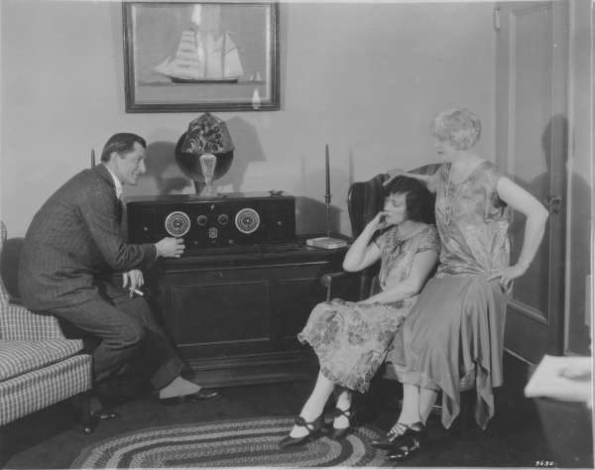
Americanization of culture
Radio increasing which helped to promote US culture and fashion
Jazz became popular
Flappers

Slide 10
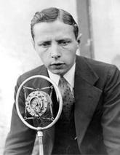
Canadian culture and identity: sport
1923 the first ever hockey radio broadcast
1931 first Hockey Night in Canada
Foster Hewitt was the voice of hockey for 60 years

Slide 11
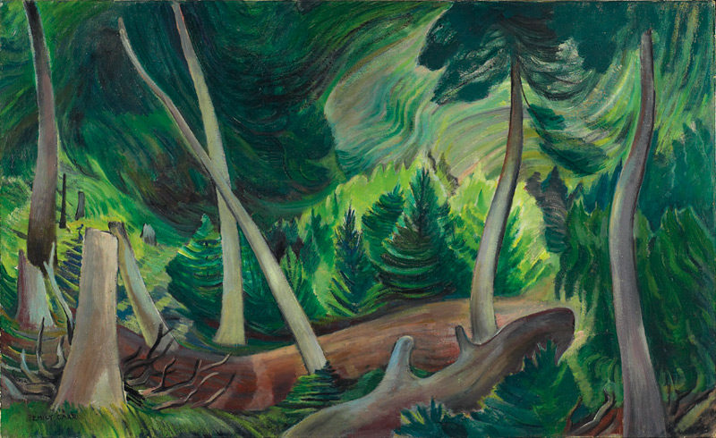
Canadian culture and identity: art
Group of Seven
Canadian landscapes in bold colours with broad strokes
Emily Carr

Slide 12
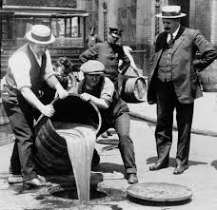
prohibition
1918 – under the War Measures Act
By 1921 provincial government repeal
Rum runners to the US made profits

Slide 13
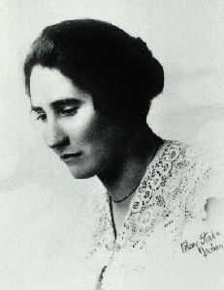
What’s going on with women’s suffrage?
1918 all Canadian women 21 years old and over (with some exceptions)
1921 first federal election
First woman MP elected in 1921 (Agnes Macphail)

Slide 14
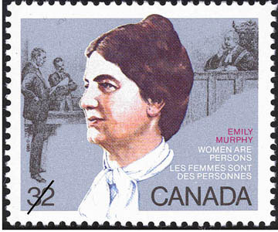
The persons case
1916 first woman judge in Alberta Emily Murphy
Her appointment was challenged
Alberta ruled women are “persons” in 1917

Slide 15
The persons case
Aug 27, 1927 The “Famous Five” asked the Supreme Court to rule on the word “persons” in the BNA Act
April 1928 The Supreme Court ruled “persons” did not include women

Slide 16
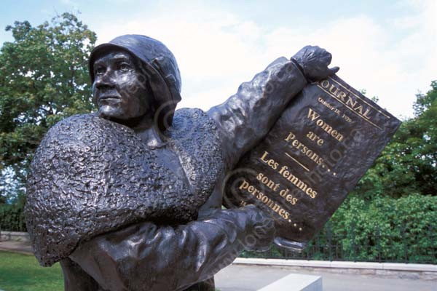
The persons case
The women appeal to the Privy Council in England
October 1929 the Privy Council ruled women are “persons”
First women senator appointed in Canada Cairine Wilson

