Slide 1
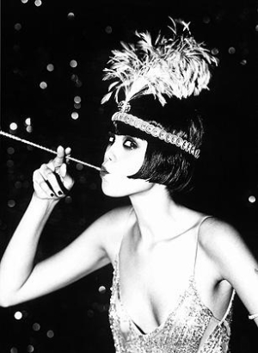
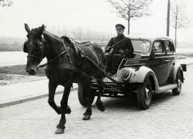
The Interwar Years In Canada
1919 - 1938

Slide 2
Do workers have the right to strike?

Slide 3
Does the government have the right to force workers back to work?

Slide 4
Do people have the right to demonstrate (protest)?

Slide 5
Does the government have the right to send in the police to end protests?

Slide 6
The Spanish Flu

Slide 7
Capitalism is
Economic system with private or corporate ownership
Distribution of goods is through the Free Market

Slide 8
Socialism is
Economic system of collective or government ownership
Stage between Capitalism and Communism

Slide 9
Communism is
As a theory is no private property, equitable distribution of goods
In practice has meant complete state control

Slide 10
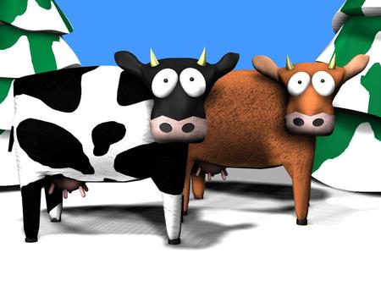
Political Philosophy Cows
Socialism: You have two cows. You keep one, but must give the other to your neighbor.
Communism: You have two cows. The government takes both and provides you with milk.
Capitalism: You have two cows. You sell one and buy a bull.

Slide 11
The Russian Revolution (1917)

Slide 12
Bolshevik and Bolshevism
Russian Social Democratic Party
Renamed Communist Party
A person with subversive or radical political views
Primarily used as a synonym for Communism

Slide 13
Strikebreaker (scab)
A person hired to work while regular employees on strike
Someone who continues to work while on strike

Slide 14
Prices increases while the value of the dollar decreases.

Slide 15
Conscientious objector
A person who refuses military service for moral or religious reasons

Slide 17
One Big Union
An attempt to organize all workers into one single labour body
In western Canada only 1919-1920

Slide 18
Sources
All images from Google Images
Definitions from Merriam-Webster Online

