Slide 1
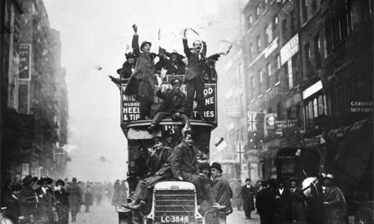
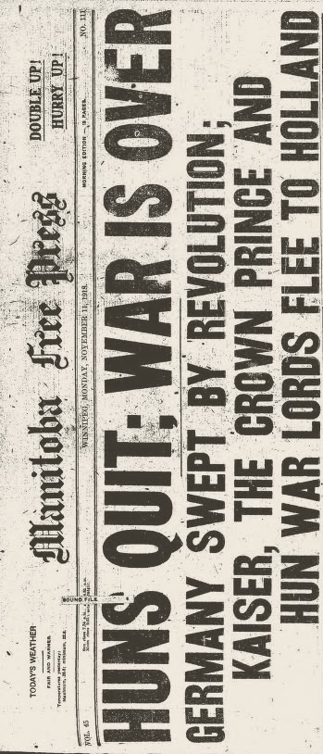
The End of the War

Slide 2
The Armistice
Nov 11, 1918 at 11am
Complete cease-fire

Slide 4
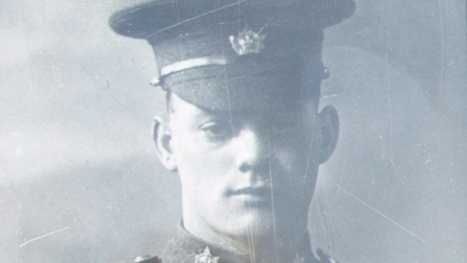
The Last Soldier
George Lawrence Price
Last Commonwealth soldier to die
2 minutes before the 11am armistice
Same place the first Commonwealth (British soldier) was killed in 1914.

Slide 5
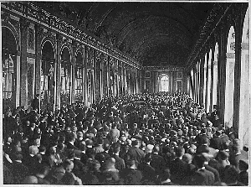
Paris Peace Conference
World leaders met in Versailles to negotiate the terms of the peace
Britain was still in charge of Canada’s foreign policy but…..

Slide 6
Assertion of Independence
PM Borden argued, successfully, that the Canadian wartime record had earned Canada the right to sit independently at the peace table.
Canada signed the Peace Treaty separately from Britain

Slide 7
Treaty of Versailles 1919
Germany was forced
to give up some European Territory and some of its colonial land
to limit the size of its military and cease production of large armaments
to pay $33 million (US) in reparations
to accept responsibility “for causing all the loss and damage” of the war

Slide 8
League of Nations
International body
Intention was to solve international conflicts without resorting to war
Canada had its own seat

Slide 9
The Butchers Bill
Estimated 9.5 to 10 million soldiers dead and 15.4 to 20 million wounded
England – 723,000 dead
France – 1,398,000 dead
Germany – 2,037,000 dead

Slide 10
The Butchers Bill
424,589 (approx. 5% of pop) with the CEF
345,000 served in France
60,932 dead, 172,950 wounded
6.5 – 7 of every 10 were killed or wounded
Approx 3% of total Canadian population

