Slide 1
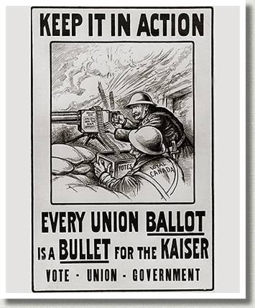
The Conscription Crisis (1917)
Notes:
Discuss what this poster suggests. Ask students if they can think of reasons for why this poster would be effective.

Slide 2
Notes:
Ask students why they think volunteer enlistment is declining. Discuss reasons including: people having a better understanding of what the war looked like and the mounting numbers of casualties.

Slide 3
Some Background
Regulation 17 – Ontario Ministry of Education, French language instruction limited to the first two years of instruction (1912/1913)
Quebec had no particular loyalty to either France or Britain

Slide 4
Some Background
There were very few Francophone people in important positions in the army
Predominately Catholic - discrimination

Slide 6
Borden’s Promise
Prime Minister Robert Borden promised no conscription
Borden promised Britain 500,000 troops
Notes:
Wh

Slide 7
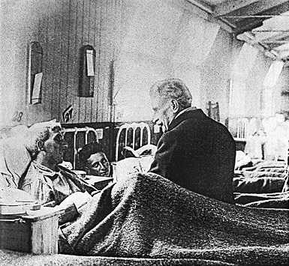
Borden’s Promise
In 1917, after visiting the troops, and facing declining enlistment Borden tabled conscription legislation

Slide 8
"Dear Sir Robert, Do you not think, in light of our population, that we have largely done our share? The people are agitated. ... In the province of Quebec; we can expect deplorable revolts. Will this not end in bloodshed?“
archbishop of Montreal, Monseigneur Bruchési

Slide 9
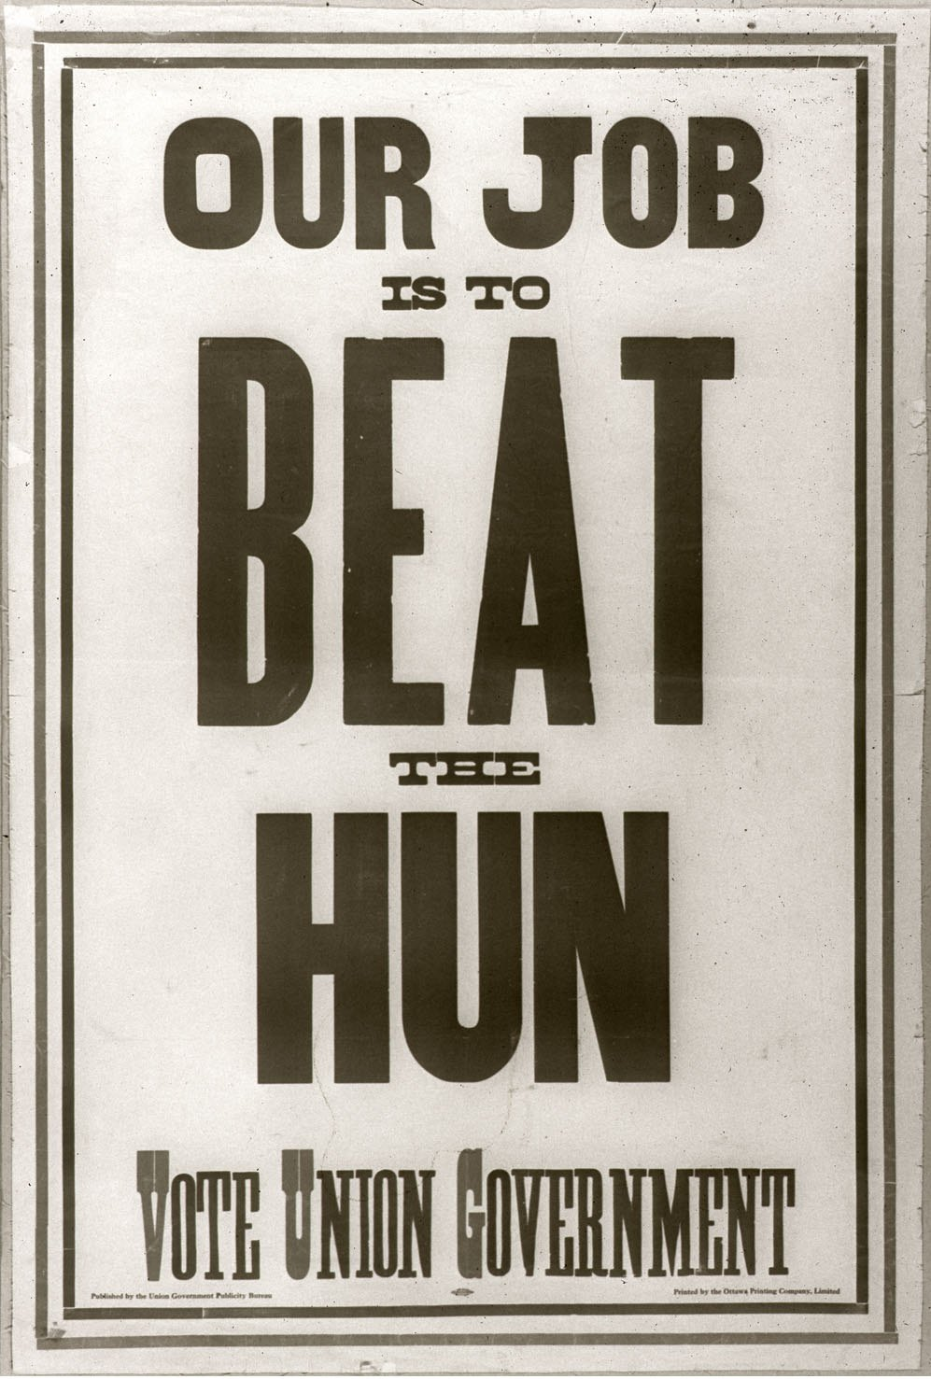

Slide 10
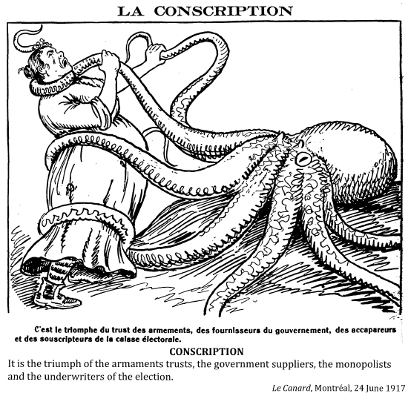

Slide 12
Against Conscription
Quebec
Farmers
Notes:
Ask the students why?

Slide 13
For Conscription
For Conscription
Soldiers
Soldiers families
Notes:
Ask the students why?

Slide 14
Get it Passed
Military Voters Act
Wartime Elections Act

Slide 15
And then we riot……
Joseph Mercier arrested at a bowling alley for not having his conscription papers, March 28, 1918 – Holy Thursday
A large crowd gathered (Mercier was released)
The crowd began to loot army registrars, shoving files and documents in the snow

Slide 16
And then we riot……
Began breaking windows of English shops
Riots in the streets of Quebec City for 4 days
Soldiers from Ontario and West brought in to put the riots down on April 1 (Easter Monday)

Slide 17
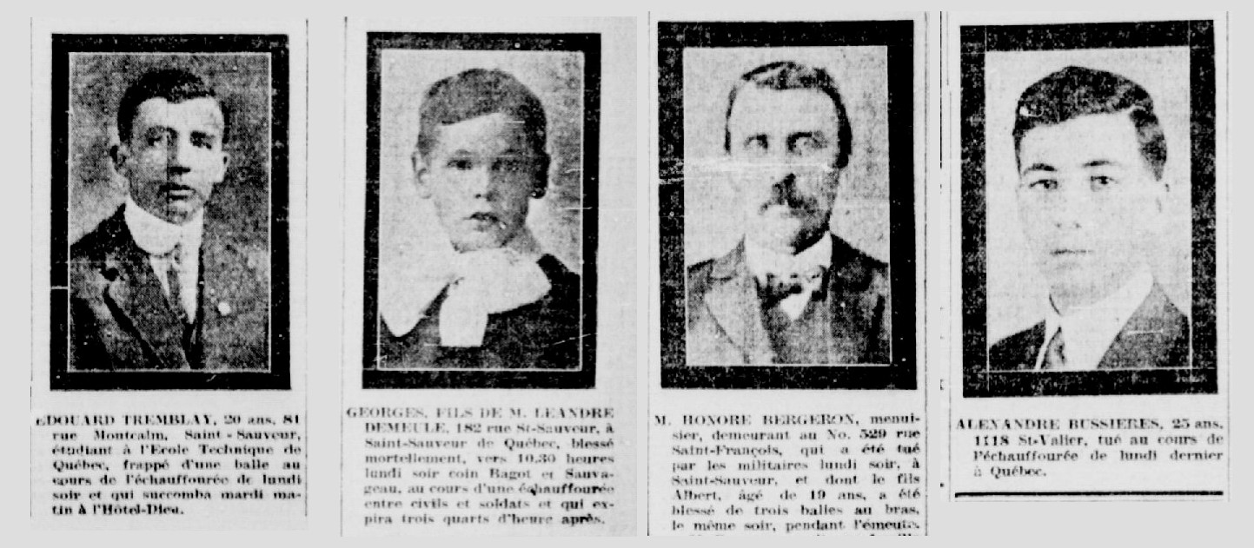
And then we riot……
4 unarmed civilians were killed
Dozens wounded

