Slide 1
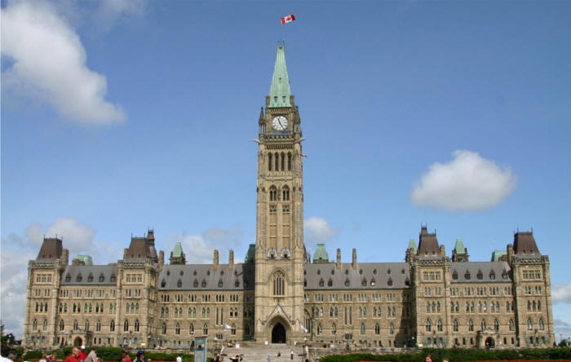
The Structure of Canada’s Government

Slide 2
Guiding Questions:
How is Canada's government organized as a representative democracy?
What are the three levels of Canadian government?
What are the three branches of Canadian government?
What is wrong with the Canadian Senate?
What should we do with the senate?
How are laws created?

Slide 3
Different Forms of Democracy:
REPRESENTATIVE DEMOCRACY: A form of government in which the people (electorate) choose a representative to voice their concerns and desires in government.
We trust in our politicians to make decisions that benefit us, the voters.
DIRECT DEMOCRACY: Each citizen participates directly in government decisions. (ie. Referendums)
These are far more common in the United States. For example, Vote “YES” on Bill 522. However, occasionally we see direct democracy in Canada. The HST referendum, for example.

Slide 4
Answer the following Questions in your Workbook
What advantages might there be to having a direct democracy over a representative democracy?
What disadvantage might there be to having a direct democracy over a representative democracy?

Slide 5
Constitutional Monarchy
Canada is a constitutional monarchy.
This means we have a monarch (king or queen) as our head of state, NOT a Prime Minister.
We also have a constitution. (A list of principles or rules that EVERYONE must follow)
The queen DOES NOT concern herself with Canadian decisions. Instead, she has a person who gives royal assent on her behalf—the governor general.

Slide 6
Should Canada remain a Constitutional Monarchy? Or should it become a republic, like France or the USA?

Slide 7
Arguments for and Against (Fill in this chart in your workbook)
Constitutional Monarchy
Republic

Slide 8
The Canadian Constitution
Written (originally the BNA Act)
3 parts:
Divisions of powers (provincial and federal.)
Charter of rights and freedoms.
Amending Formula. (How to change the constitution)
Federal government must agree.
Seven of the ten provinces must agree.
These seven provinces must make up at least one half of Canada’s population.
Unwritten
Rules and practices concerning the roles and functions of parliament.
For example, Political parties are not mentioned in the Written Constitution.

Slide 9
The Federal System
A federation is an organization of regional governments (provinces) responsible for local matters, and a central government (Ottawa) that is responsible for matters vital to the nation as a whole.
However, the provincial government gives up some of its powers to municipal governments. (towns and cities)
Therefore, in practice, Canada has three levels of government: Federal, Provincial, and Municipal.

Slide 10
Federal System Division of Powers
Federal | Shared | Provincial
National Defence Foreign Policy Aboriginal Affairs Postal Services Banking System Criminal Law Federal Prisons Any RESIDUAL POWERS go to the federal government. | Immigration Agriculture Health Care Natural Resources Environmental Issues | Education Charities Health and Services and Hospitals Highways Provincial Courts Provincial Police and Prisons

Slide 11
Questions
Brainstorm how government has affected you since you woke up this morning?
What organizations do you belong to that have a constitution?
Why is a constitution necessary in a complex organization?
What advantages do you think a federation, like Canada’s, might have?
What disadvantages might a federation have?
In a well-structured paragraph, argue whether or not Canada should keep the Queen of England as our head of state?

Slide 12
The Parliamentary System
In Canada, the powers of government are divided into three branches:
Legislative
Executive
And Judicial

Slide 13
Three Branches of Government
The Legislative Branch:
This branch legislates, or creates and amends laws.
All three levels of government (federal, provincial, and municipal) have the ability to legislate. But each level can only create laws that fall under its power under the constitution.

Slide 14
Legislative Branch
The legislative branch is composed of:
The governor general
The House of Commons (MPs)
And the Senate

Slide 15
Legislative Branch
Governor General
Is the representative of the queen and is chosen by the Prime Minister.
Technically, the government needs to the Governor General’s “royal assent” to pass any law.
In practice, however, the governor general VERY rarely refuses to sign laws that have passed through parliament.
For all intents and purposes, the Governor General is a figure head.

Slide 16
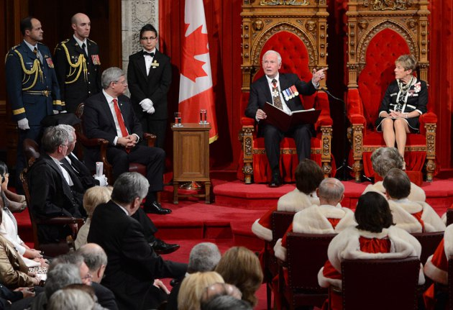
David Johnston, our current G.G.

Slide 17
Legislative Branch
House of Commons (Ottawa)
The House is occupied by 308 elected Members of Parliament. (MP)
Each MP represents a riding, or constituency, composed of about 100,000 people.
Usually, MPs belongs to a political party, and when these parties meet privately it is called a caucus.
The party with the most MPs, or seats, forms government.
The party with the second most numbers of seats is called the official opposition, whose job is to scrutinize the actions of government.
The speaker of the house is elected by parliament to act as a referee and make sure MPs follow rules of parliamentary etiquette.
Parties usually have a party whip, who disciplines rogue MPs who voice opinions that differ from the rest of their party.

Slide 18
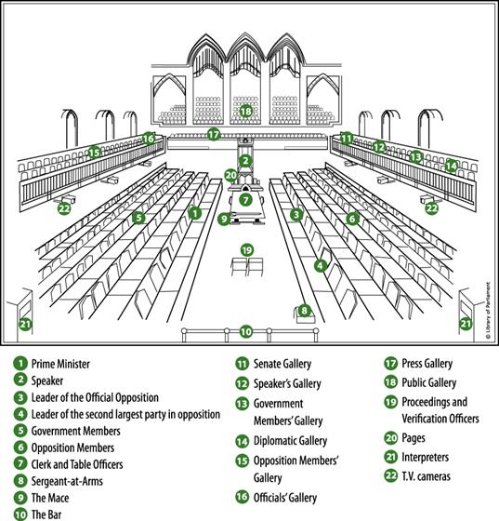
House of Commons

Slide 19
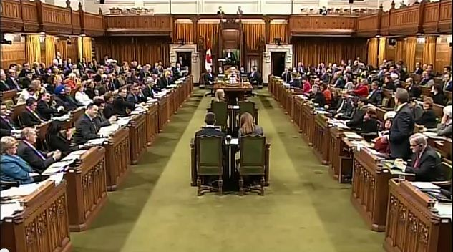
House of Commons (Lower House)

Slide 20
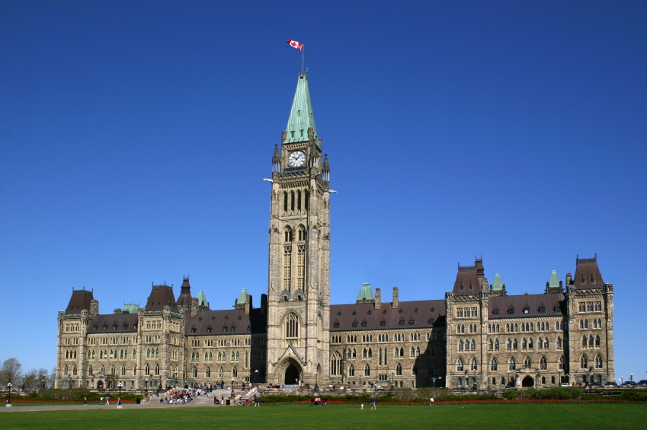
Parliament Building in Ottawa

Slide 21
Legislative Branch
Senate
Senators are unelected! They are appointed by the governor general on the recommendation of the prime minister.
Usually, this means that senate appointments are used by the Prime Minister as a way to reward the party faithful, or political patronage.
Once appointed, senators may serve until they are 75 years of age.
The Senate was originally meant to act as a sober second thought, or a means of countering the mood swings of the electorate and the House of Commons.

Slide 22
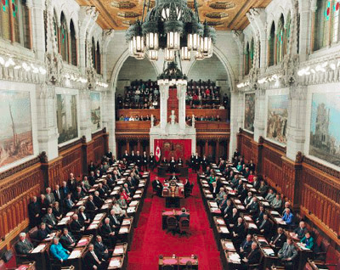
The Senate (Upper House)

Slide 23
Executive Branch
This branch executes, or administers, government. In other words, it carries out the everyday tasks of government.
It is composed of four parts:
Governor General
Prime Minister
Cabinet
Public Service

Slide 24
Executive Branch
Prime Minister (head of government)
The Prime Minister is the leader of the party that holds the most seats in parliament.
Is elected by party members.
Names new judges.
Names new senators.
Chooses cabinet members
Has the final say in creating policies of the government in power.
Explains the goals of the ruling party.
Represents Canada abroad.

Slide 25
Executive Branch
Cabinet
Made up of MPs who are chosen by the PM.
Usually each cabinet member has a designation. (ie. Minister of Defense, Minister of Justice, etc.)
Each cabinet minister employs and relies heavily on a large support staff.
In the end, however, the cabinet members must follow the wishes of the party. (cabinet solidarity)
If not, then they can be booted from cabinet, and possibly the party, by the party whip.

Slide 26
Executive Branch
The Public Service (civil service)
A group of permanent employees who perform the ongoing business of government.
Public servants work as teachers, judges, Tax collectors, garbage collectors, Canada Post workers, etc.

Slide 27
Judicial Branch
This branch interprets and applies the laws that are created by parliament.
It includes judges and the courts and operates independently from the other branches of government.
The supreme court of Canada is the highest court in Canada, and it has the final say on all legal questions in the country.

Slide 28
Judicial Branch
The Supreme Court of Canada
The supreme Court has nine judges from four regions of Canada.
Three from Quebec
Three from Ontario
Two from Western Canada
One from the Maritimes
When a Supreme court judge retires, he is replaced by a judge chosen by the Prime Minister.

Slide 29
Questions
What problems might arise from having the Prime Minister appoint Supreme Court Judges?
What alternative might there be to this?

Slide 30
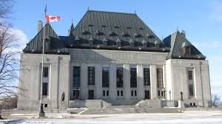
Supreme Court of Canada

Slide 31
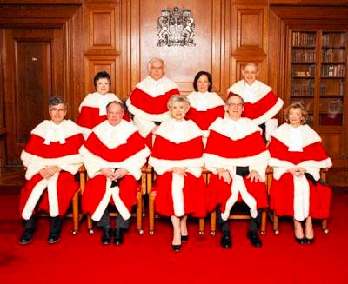
Supreme Court of Canada

Slide 32
Task
Create two charts to visually demonstrate:
the three levels of government, and
the three branches of government.
Be sure to include a short description with each branch, level, and position.

Slide 34
Review
What are the three branches government in Canada?
What is the difference between the Executive and Legislative branch?
What is the Supreme Court of Canada’s Role?
Who chooses the Supreme Court Judges?

Slide 35
How are Laws Created?
Who decides what ideas become official laws?
What is the process that must be followed to assure that these laws are good ones?
Why is the process so lengthy?

Slide 36
What is the difference between a “bill” and a “law”?

Slide 37
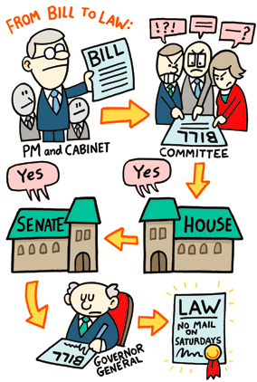

Slide 38
How a Bill Becomes a Law
1. FIRST READING
Any idea for a new law or a change to current law is written down. The idea is now called a bill. The bill is printed and read in the House it is starting from.
Bills are usually introduced by cabinet ministers. If not, then they are called Private Member’s Bills.
There is no real debate at this stage. The first reading is a formality.
If the bill starts in the House of Commons, it is a C-Bill.
If it starts in the Senate it is an S-Bill

Slide 39
How a Bill becomes Law
2. SECOND READING
The bill is given a Second Reading in the House it is starting from.
At this point, parliamentarians debate the idea behind the bill.
They consider questions such as, “Is the idea behind the bill good?” “Does it meet people’s needs?” “Who will be affected by this bill?”
If the House votes for the bill and it passes this stage, it goes to a committee of the House, which usually meets in a smaller committee room outside the Chamber.

Slide 40
How a Bill becomes Law
3. COMMITTEE STAGE
At the Committee Stage, the bill is studied carefully.
Committee members hold hearings or special meetings where different people inside and outside government can make comments about the bill.
The committee can ask for government officials and experts, or witnesses, to come and answer questions.
The committee can suggest changes or amendments to the bill when it gives its report to the House.

Slide 41
How a Bill becomes a Law
4. REPORT STAGE
At the Report Stage, the committee reports the bill back to the House.
All parliamentarians can then debate it.
During this stage, those who were not part of the committee that studied the bill can suggest changes to the bill.

Slide 42
How a Bill becomes Law
5. THIRD READING
The bill is then called for a Third Reading. The parliamentarians debate it again.
Sometimes they can change their minds about a bill. They might vote for it at Second Reading but not at Third Reading if they do not like the changes made to the bill.
If it passes Third Reading, the bill then goes to the other House where it goes through the same stages.
A bill must receive a majority (over 50 %) of the votes for it to pass.

Slide 43
How a Bill becomes Law
6. ROYAL ASSENT
Once both the Senate and the House of Commons have passed the bill in exactly the same wording, it is given to the Governor General (or his or her appointed representative) for Royal Assent (final approval), and it can become law.

Slide 44
How a Bill becomes a Law
The legislative process (creating laws) is a very repetitive and time consuming process. Do you think it is necessary? Why? Why not?
What if the government in power has a majority of the seats in parliament?

Slide 45
Review
What are the three parts of Canada’s written constitution?
What are the three levels of government?
What are the three branches of government?
What are the six steps a bill must follow to become a law?

Slide 46
Provincial/Territorial Governments
Read pages 240-246 and answer the following questions:

Slide 47
How is the structure of the Provincial government similar to the Federal Government? | How is the structure of the Provincial Government different from the Federal government?

Slide 48
Provincial/Territorial Government
Questions
Identify five responsibilities of a provincial government. Include two points for each one.
Create a diagram illustrating the structure of Local government. Include several points describing each position/level.
Identify six responsibilities of a local, or municipal, government.
Who is the leader of an Aboriginal local government?
Identify the differences between Aboriginal local government, and local government in a city off reserve.

Slide 49
Chapter 10: The Citizen and the Government
Guiding Questions:
What roles do political parties play in Canadian politics and decision making?
Is our first-past-the-post system fair?
How do lobby and pressure groups influence government decisions?
How can individuals influence political decision makers?
What role do the media play in influencing policy decisions?

Slide 50
Elections
In Canada, you must meet two requirements to vote:
Be at least eighteen years old.
Be a Canadian citizen
However, voter turnout in Canada is usually very low, in some municipal elections it can be as low as 20%.
“Voter Apathy” is highest amongst young voters.
This group seems to know and care the least about how government functions and who is in power.

Slide 51
Elections
According to the Constitution, a federal election must be held every five years at the latest, and Prime Ministers can request an election any time during.
In 2007, legislation was passed that created a fixed election date.
Accordingly, elections are held on the third Monday in October in the fourth calendar year after the previous election.
However, the Prime Minister is still free to call an election before this time.

Slide 52
Elections
In British Columbia, provincial elections must be held on the second Tuesday in May, every four years.
Also in British Columbia, municipal elections must be held on third Saturday in November every three years.

Slide 53
The Electoral Process
The electoral process in Canada is set out in the Canada Elections Act, and It can be considered to have six stages:
Dissolution
Enumeration
Nomination
Campaigning
Balloting
Tabulation

Slide 54
1. Dissolution
One of the ceremonial duties of the GG is to dissolve the HOC. They do this on the recommendation of the Prime Minister.
At this point the MP’s are dismissed from the HOC and a new election date is suggested by the PM. This must be within 50 days of the date of dissolution.
However a vote of non-confidence could force an election at any time during a 4 year term. (Speech from the throne, budget, etc.)

Slide 55
2. Enumeration
Following dissolution the GG asks the Chief Electoral Officer, to issue election writs.
Returning officers make up the list of voters’ names “returned” to the constituency office and the election results “returned” in that constituency on election day.
The preparation of the voters’ list is known as enumeration.
When people go to vote they go to Polling Stations (generally set up in schools etc.)
Each polling station has its own list of voters. On average each polling station has about 250 voters names on their lists.

Slide 56
3. Nomination
As soon as election writs are issued, each party must decide who will be its candidate in each constituency. The selection of candidates is known as Nomination.
Any Canadian citizen 18 years or older may be nominated as a candidate.
Parties generally select a candidate for each constituency at a nomination meeting, held in that riding. Party members present at the meeting vote until one of the people seeking the nomination has a majority.
People without any attachment to a political party who become candidates are called independents
Every candidate must make a deposit of 200$ with the returning officer for the constituency. They must also present nomination papers containing the signatures of 25 other electors. If the party leader officially endorses the candidate, the latter’s name will be listed on the ballot for that constituency on election day.

Slide 57
4. Campaigning
The Campaign takes place from the time when election writs are issued to the weekend before election day.
The Parties and candidates present themselves to the public through the various media and public meetings, in an attempt to convince the public to vote for their parties candidate.

Slide 58
5. Balloting
On the day of a federal election each polling station is open from 8 am to 8 pm
Employers are required by law to allow their workers time to vote.
In most cases, polling stations are located in a neighborhood school, church, or community centres.
Advance Polls exist for people who for one reason or another can not vote on election day.
Each polling station is manned by a Deputy Returning Officer who is responsible to the Returning Officer. When a voter enters a polling station, his or her name is checked by the DRO against the list of voters prepared for the poll.
The DRO gives the voter a ballot, the voter pencils an “X” in the box beside the name of the candidate he/she favors. The voter then folds the ballot, leaves their booth and gives the ballot to the DRO, who drops it into a special locked box.
The vote has been cast.

Slide 59
6. Tabulation
Once the polling stations close, the ballot boxes are opened and the ballots are counted by the D.R.Os.
These days computers tabulate the voting results for many polls.
At the close of voting, local television and radio stations can legally begin to broadcast the results as they come in.

Slide 60
A few notes:
Canada is divided into 308 constituencies (ridings) and each constituency has a seat in the House of Commons.
Each constituency has about 100,000 people living within in its boundaries.
During election time, each major political party runs a single candidate in almost every constituency.
The candidate with the most votes in that constituency wins the seat in the House of Commons.

Slide 61
A few notes
After the election, the political party with the most seats in the House of Commons gets to form government.
The leader of this party (also an MP) becomes the head of government, or the Prime Minister.
If this party in power has more than 50% of the seats in the House of Commons, it is a majority government.
If this party in power has less than 50% of the seats in the House of Commons, it is a minority government.
Because legislation needs more than 50% of the votes in the house to pass, minority governments need the support of the opposition to pass laws.

Slide 62
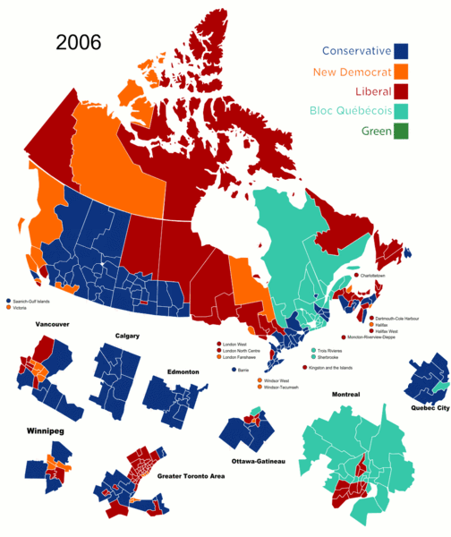

Slide 63
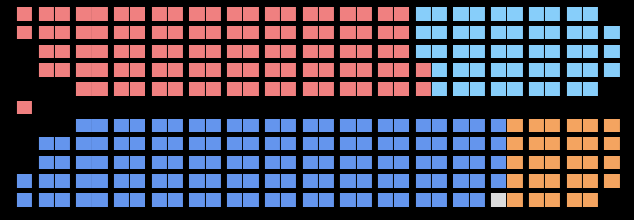
House of Commons (2006)
Blue: Conservative Grey: Independent
Orange: NDP Red: Liberal
Teal: Bloc Quebecois

Slide 64
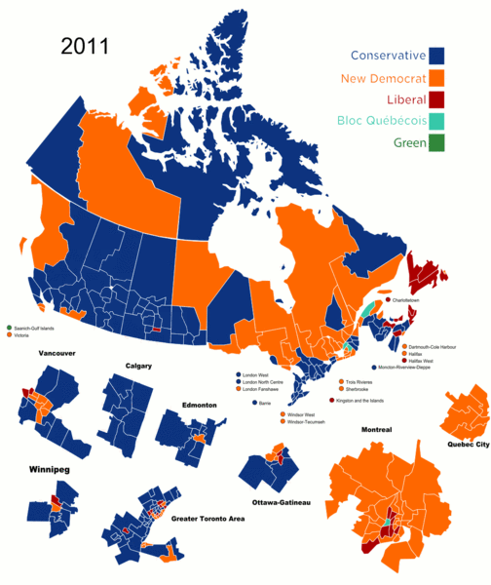

Slide 65
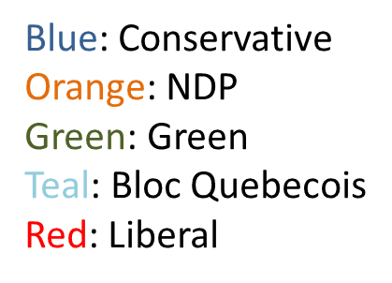
House of Commons (2011)

Slide 66
Political Spectrum
A political spectrum is a system of classifying different political positions upon one or more geometric axes that symbolize independent political beliefs.
On this axis, political beliefs can be considered Left Wing, Centre, and Right Wing.
The classification originated after the French Revolution when the clergy, nobility, and monarchists sat in the right side of parliament, and the elected commons sat on the left.
Thus, the term "right-wing" became associated with maintaining the status quo and protecting the interests of the established elites, like the nobility, clergy and the wealthy.
The term "left-wing" became associated with demanding progress and equality.

Slide 68
Problems with Single axis Political Spectrum
It is too simple. Several political ideologies do not fit on the single axis spectrum.
Libertarianism, for example, believes in complete personal freedom from government and complete economic freedom from government.
So, a new two-axes political spectrum was created.

Slide 69
Two Dimensional Political Spectrum

Slide 70
Socialism
Socialism is not a single movement, rather it is an umbrella term that covers a wide range of beliefs that are united in thinking that people should be equal and that wealth needs to be redistributed to make this possible – a Robin Hood principle, of taking from the rich to give to the poor.
Socialists believe that the state must promote this equality.
Radical Socialists
call for nationalization (government ownership) of all businesses on behalf of the workers. This requires dictatorial government to force it through. (Communism)
Moderate Socialists
call for progressive taxation (taxing the rich and businesses at higher rates than others) to fund services for the poor.
generally favour a mixed economy of independent business and state controlled key services.

Slide 71
Socialism
Moderate Socialist States:
Sweden (tax rate can go up to 60%)
Finland
Norway
Radical Socialist States:
Cuba
North Korea
China (to some extent)

Slide 72
Communism (Marxism)
All Communists are Socialists, but not all Socialists are Communists. Communism is a radical subset of Socialism.
German intellect Karl Marx believed that as a country’s economy industrializes and matures, the wealth will inevitably become more and more concentrated into the hands of a few.
This, he felt, will lead to a Communist Revolution, in which the proletariat (workers) take back the means of production (industry) from the bourgeoisie (capitalists or business owners).
Communists believe it is the duty of the state (government) to develop economic equality so that citizens can share in the wealth created by industry.
Under communism, there is no private ownership of business.
In an ideal communist state, there are no classes. Everyone is equal.
This is rarely the case. Usually, the business elite are replaced by the political elite.

Slide 73
Communism
Communist States:
The former USSR (Russia is no longer communist)
North Korea
China
Cuba
Vietnam

Slide 74
Liberalism
Individualism: The individual takes priority over society.
Freedom: Individuals have the right to make choices for themselves, and these freedoms must be protected by the government through a human rights code.
Equality: No person is morally or politically superior to others. Hierarchies are rejected. Success should be decided by hard work
Progress: Traditions should not be kept unless they have value. New ideas are helpful because they can lead to progress in the sciences, the economy, and society. Liberals do not fear change.
The free market: Liberalism and capitalism go hand in hand. Liberals like the free market (little government intervention)because it more easily creates wealth, as opposed to traditional economies, which often have extensive regulations and limits on which occupations people can hold.

Slide 75
Conservatism
Social Conservatism
Conservatives are generally reluctant to change or reform things. Tradition is preferred.
Conservatives often support such institutions as family and church.
Conservative fear that too much change merely brings disruption.
Believe the justice system should be tough on crime. (Longer sentences)
Fiscal Conservatism
The Government should have little influence over the economy. (Few regulations, tarriffs, and duties)—”Laissez Faire “Capitalism
Low taxes and reduced government spending.

Slide 76
Conservatism
Conservative States:
The Republican Party in the USA is both socially and fiscally Conservative.
The Conservative Party in Canada is both socially and fiscally Conservative.

Slide 77
Fascism
The word Fascism was first used by Benito Mussolini during his reign as leader of Italy from 1922-1943.
Action over thought. If it works, do it. Do not make decisions based on morals or ethics.
Extreme Nationalism. (Love of country and willingness to sacrifice virtually everything for it.
It is the purpose of the individual to serve the state. Obedience and service are the ultimate duties of citizens. (In a democracy, the state serves the citizens.)
Militaristic. The military is heavily funded and must play a strong role in governing a country.
Fascist economies tend to value private property and business, as long as they are contingent to the service of the state.
The State is more important than any individual.

Slide 78
Fascism
Examples of Fascist States:
Fascism was initially a term used to define Fascist Italy; however, over the years the term has been used loosely to describe Nazi Germany and other authoritarian regimes.

