Slide 1
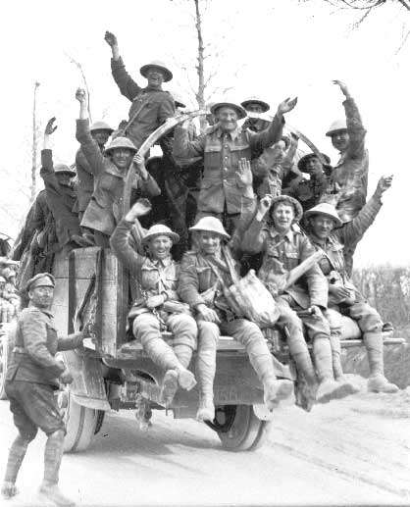
Significant Canadian Battles
World War 1

Slide 2
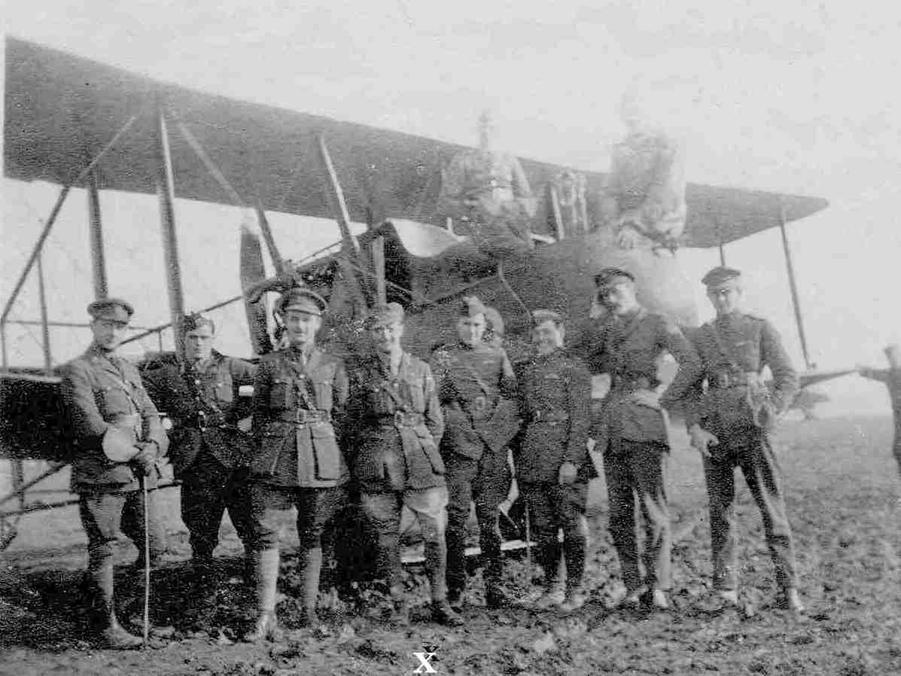
The War in the Air

Slide 3
The War in the Air
Air Training programs established in Canada
By the end of the war 40% of British Pilots were Canadian

Slide 4
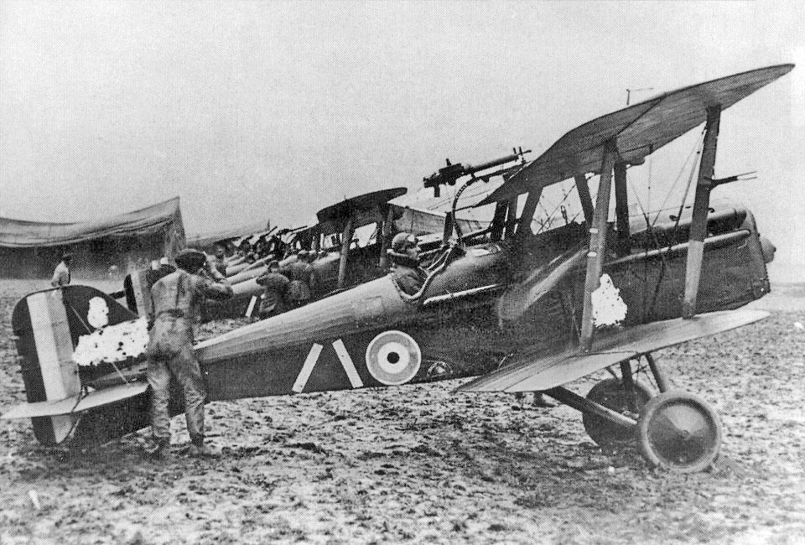
The War in the Air

Slide 5
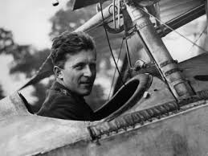
ACES

Slide 6
The War at Sea
Supply ships were very important to both sides
Both sides used their navy to prevent supply ships from reaching their destinations
Germany had more submarines (U-Boats) to attack British ships

Slide 7
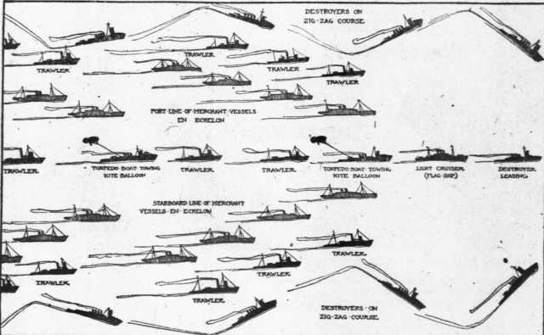
The War at Sea

Slide 8
The War at Sea
2600 allied ships sunk by U-Boats (45 Canadian)
In 1915, a U-Boat sank the Lusitania, more than half the passengers were lost including 128 Americans

Slide 9
The War at Sea
The Canadian Navy grew dramatically during the War
At the start the Canadian Navy was 2 second-hand cruisers
By 1918, it was 100 ships
These ships played an important role in escorting convoys

Slide 10
The War on Land
The CEF started as a division under British Command
In September 1915 the Canadian Corps was formed
Operational and administrative grouping of most Canadian fighting units and their supporting services

Slide 11
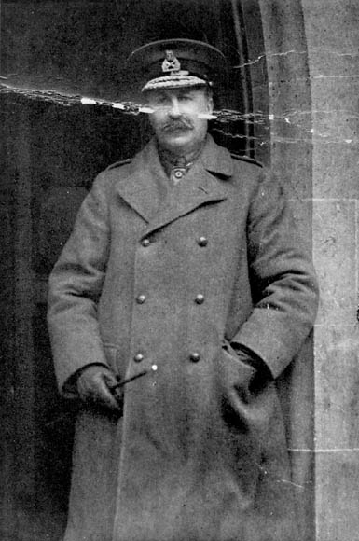
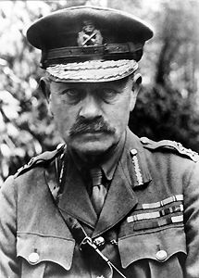
The War on Land
Lieutenant-General Sir E.A.H Alderson
Lieutenant-General Sir Julien BYNG

Slide 12
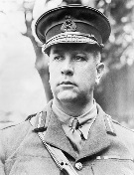
The War on Land
Lieutenant-General Sir Arthur CURRIE

Slide 13
The War on Land
Grew from 35,000 troops in 2 divisions in 1915 to 100,000 troops in 4 divisions by early 1917

Slide 14
Significant Land Battles
The Second Battle of Ypres
The Battle of the Somme
The Battle of Vimy Ridge
The Battle of Passchendaele
Canada’s Hundred Days

Slide 15
Casualties
In a war it is the number of people taken out of active service (includes wounded, dead, captured, and missing)

Slide 16
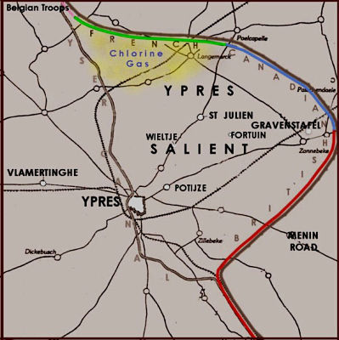
Salient

Slide 17
Rolling Barrage
Basically, artillery would provide a “curtain” for the advancing infantry
Strict coordination and timing was essential for success

Slide 18
Your Assignment Part 1
In groups you will study one of the 5 major Canadian Battles
You will be experts on that battle
You will form new groups and teach the new group about your battle
Fill out Significant battles sheet

Slide 19
Your Assignment Part 2
Using the information you have gathered complete the ranking sheet
The entire package is due on Thursday (you will have time in class on Wednesday as well)

