Slide 1
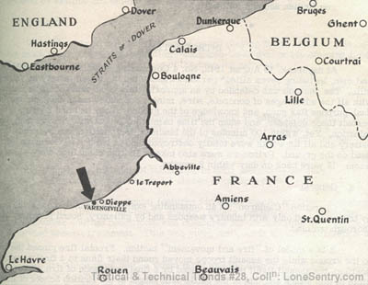
Raid on Dieppe
Canadian Catastrophe?

Slide 2
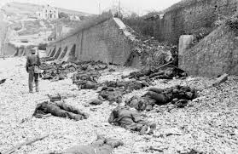
The Numbers
Total allied troops 6033
4963 Canadian troops
907 were killed
587 were wounded
1946 were captured

Slide 3
Under Pressure
Canadians had been stationed in Britain with little to do
Number of crimes and out-of-wedlock pregnancies on the rise
British under pressure from the Soviets to open the western front and remove some pressure from the east
US also wanted to see the western front opened

Slide 4
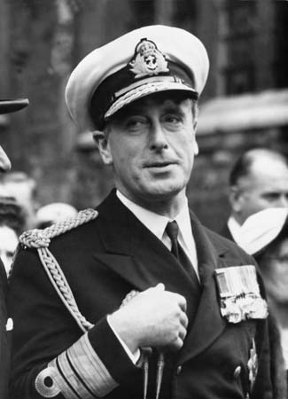
Lord Louis Mountbatten
Mandate: series of escalating raids to hit the Germans in the west
Keeping the Germans on their toes
“At best these raids were mere pinpricks against the German controlled continent”
In charge of the operation

Slide 5
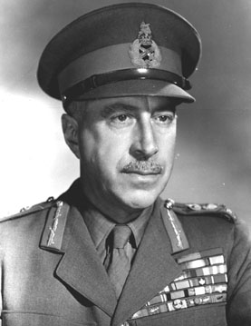
Lieutenant-General Harry Crerar
Temporary command of the Canadian Army
Pushed aggressively to have the Canadians included in the major raid directed at the French coast

Slide 6
The Point
Test of combined arms and inter-service cooperation
Challenge to German defences
“Pinch raid” to capture important intelligence information

Slide 7
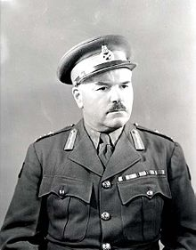
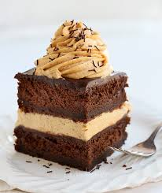
The Plan
Canadians would take the lead but it was planned by Mountbatten’s headquarters
2nd CID was under the Command of Major-General J. Hamilton Roberts
Considered the best in the Canadian Army

Slide 8
Operation Rutter
Set for early July 1942
German air raid on concentrated troop shops – destroyed a chance at surprise
Poor weather on the planned day would have meant an uncoordinated attack
Since surprise and shock were vital to success – operation canceled

Slide 9
Operation Jubilee
Germans would never believe that they would mount a second identical operation
Navy pulled back its involvement (Battle in the Atlantic had it spread thin)
Bomber Command pulled back its involvement (did not want to risk assets)
Fighter Command made a large commitment

Slide 10
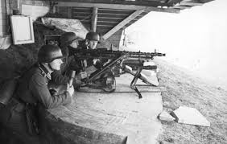
August 19, 1942
The troops would land on the beaches at Dieppe, demolish fortifications, wreck harbour facilities, kill Germans, and withdraw
It was not going to be easy

Slide 11
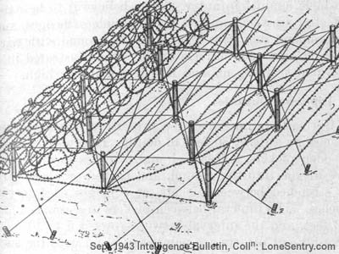
August 19, 1942
Germans had the higher ground
Germans were “dug in”
Dieppe was heavily fortified
Wire entanglements and concrete barriers
Demolished any cover on the beaches

Slide 12
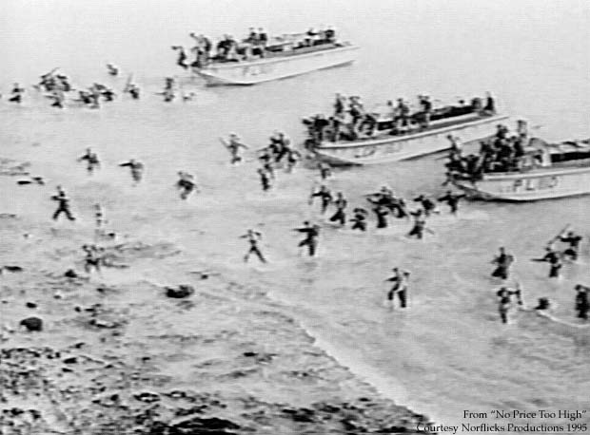
Day of Infamy
First and second waves hit hard as the doors opened on the landing vessels
Those that made it to the beach were trapped
The German machine guns were relentless

Slide 13
Propaganda
The spin: The raid was a success because it taught valuable lessons about staging an amphibious assault on France
Once the casualty lists were released the spin became harder to maintain
Germans used footage from their side to demonstrate the strength of the German army

Slide 14
What about the plan?
The plan was flawed
Success required surprise, speed, and darkness
Instead the enemy was prepared, had the advantage of terrain and fire power
Sir Bertram Ramsay “Dieppe was a tragedy, and the cause may be attributed to the fact that it was planned by inexperienced enthusiasts”

