Slide 1
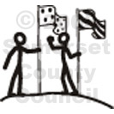
Nationalism
A cause of World War 1?

Slide 2
What does Nationalism Look like?
http://media.forces.ca/_VIDEOS2010/ad_ready_prets_60s_en.mp4

Slide 3
What does Nationalism look like?
http://www.tcm.com/mediaroom/video/378585/All-Quiet-On-The-Western-Front-Movie-Clip-Life-Of-The-Fatherland.html

Slide 4
What do you think?
What is nationalism?
In what way could it contribute to the start of a war?

Slide 5
The Terms
A Country is ….
A large area of land that is controlled by its own government
A State is….
A politically organized body of people usually occupying a defined territory.
A Nation is ….
People whose common identity creates a psychological bond and a political community. Their political identity usually comprises such characteristics as a common language, culture, ethnicity, and history. A nation-state is a state populated primarily by the people of one nationality.
The terms are often used interchangeably but for our purposes we are going to differentiate between Country/State and Nation.

Slide 6
The Terms
Patriotism is….
A cultural attachment to one’s homeland or devotion to one’s country. National loyalty.
Jingoism is….
Extreme belief that your own country is always best, often shown in enthusiastic support for a war against another country.
Nationalism is….
A feeling that people have of being loyal to and proud of their country often with the belief that it is better and more important than other countries.
A desire by a large group of people (such as people who share the same culture, history, language, etc) to form a separate independent nation of their own.

Slide 7
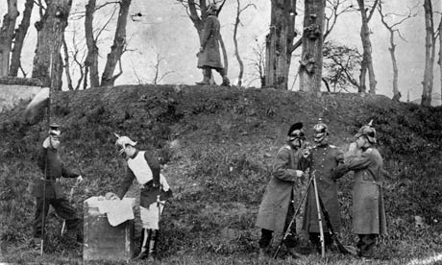
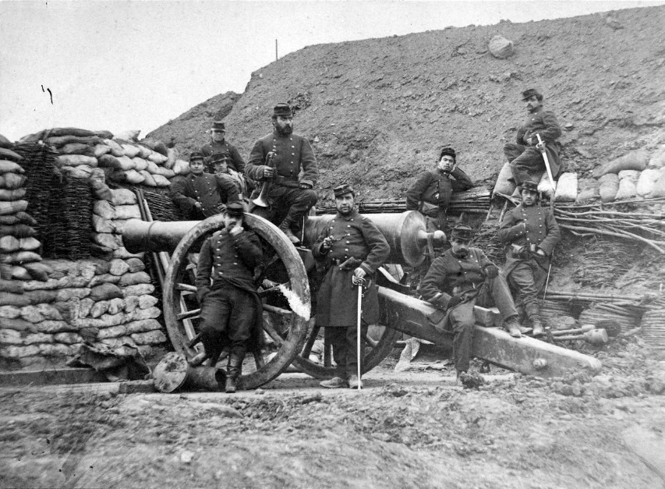
Germany did not exist before 1871. What came to be known as Germany was a series of Princedoms. The most powerful of which was Prussia.
Prussia had a strong military and put it to use in order to defeat France in the Franco- Prussian War in 1871.

Slide 8
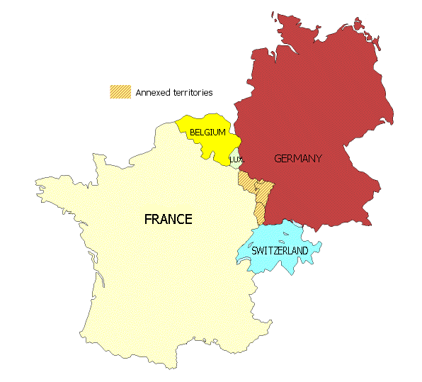
The Treaty that ended the war…. The Treaty of Frankfurt ….demanded compensation from France AND the territory Alsace Lorraine in the Rhine valley (long disputed territory, populated by predominately Germanic speaking peoples).
AND
United the Germanic Princedoms into a single German Empire (it was easier to secede than to fight the incredible strength of the Prussians).

Slide 9
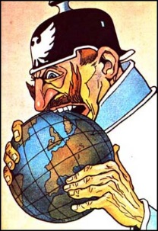
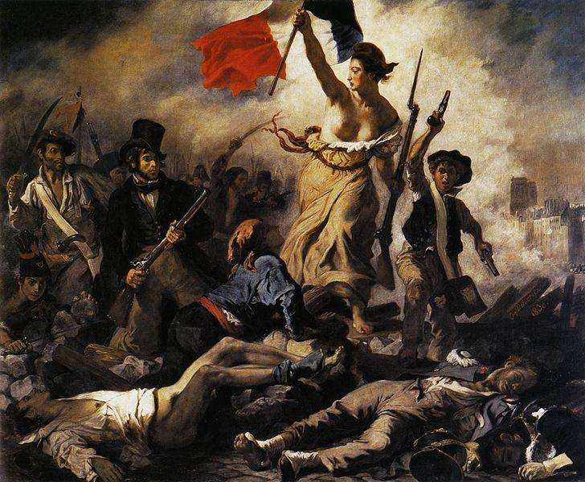
Germany now had a vested interest in “nation-building” In order to forge a strong singular national identity rather than individual state/princedom identities.
The defeat suffered by France also inspired a surge in nationalism.
A desire to “re-claim” the lost territory that was “rightfully theirs”

Slide 10
Sources
Definitions from: http://www.merriam-webster.com/dictionary/
Images from: Google Images

