Slide 1
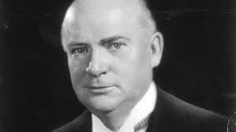
Prime Minister W. L. Mackenzie King
1921-1926, 1926-1930, and 1935-1948

Slide 2
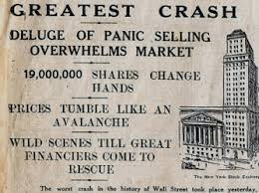
Failure to Act
Stock market crash in 1929
Bennett (opposition leader) demanded action
King did not believe there was a need
Assumed only speculators hurt

Slide 3
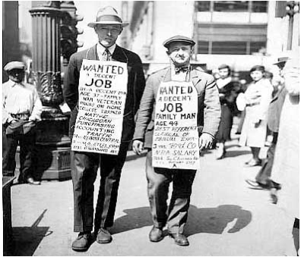
Failure to Act
Talk of unemployment was exaggerated
It was early and only starting to register a drop, next spring will bring more jobs and higher prices
It was a temporary recession

Slide 4
Five-Cent Piece
Conservatives argued financial assistance to the provinces was needed
King saw it as partisan politics and said he “would not give them a five-cent piece”
Used against him in the election

Slide 5
Banks
Proposed a government-controlled banks
The state should play a role in determining fiscal policy
More intervention than the Bank of Canada

Slide 6
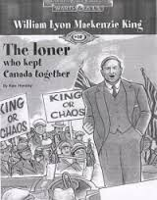
King or Chaos
Ran against Bennett in 1935
People discontent under conservative government re-elects the liberals under King

Slide 7
Trade with the US 1935
Election promise was to negotiate a trade treaty with the US
Within two weeks of taking office went to Washington and returned with a deal
Modest but gave Canadian farm products access

Slide 8
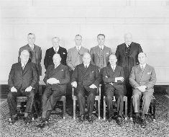
Consultations
Conference with premiers
Federal grants to provinces continued to 1936
Objective to have each level of government pay for its programs from its own tax sources
Assumed new distribution of powers would emerge from discussion

Slide 9
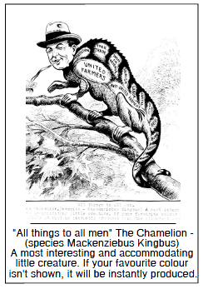
Social Welfare
Relief to farmers
Laid the groundwork for national unemployment insurance
National Housing Act (1938)

Slide 10
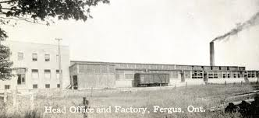
A little more to think about
Focused on industrial areas (Ontario and Quebec)
Reluctant to adopt Keynesian Economics but did provide some federal funding to stimulate economy

