Slide 1
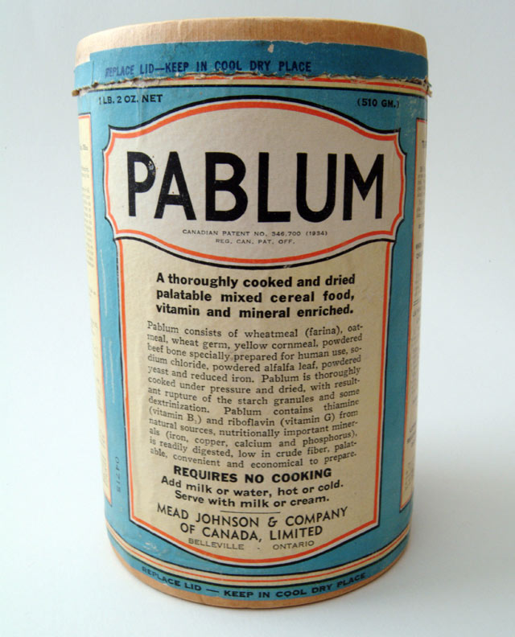
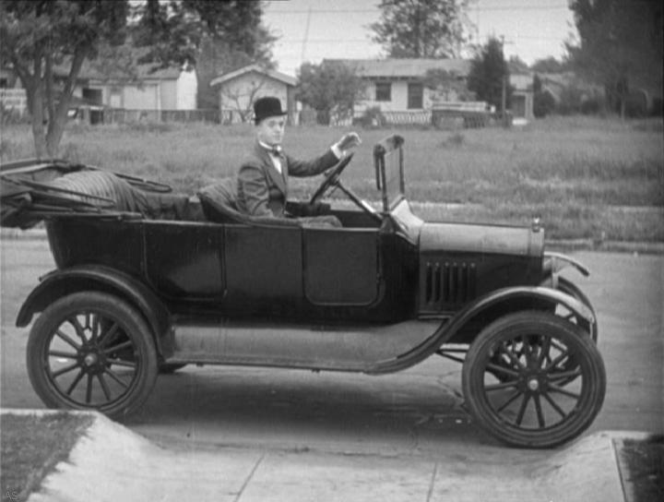
Legacies of the 1920s and 1930s

Slide 2
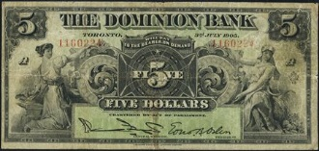
Social Reform – Old Age Pensions
1927 – Government passed the Old Age Pension Act
Max $20/month

Slide 3
Social Reform – Old Age Pensions
Requirements
Must be British subject 70+
Must have lived in Canada for 20+ years and in current province 5+ years
Must have annual income <$365
Cannot be Status Indians
And they had to prove it

Slide 4
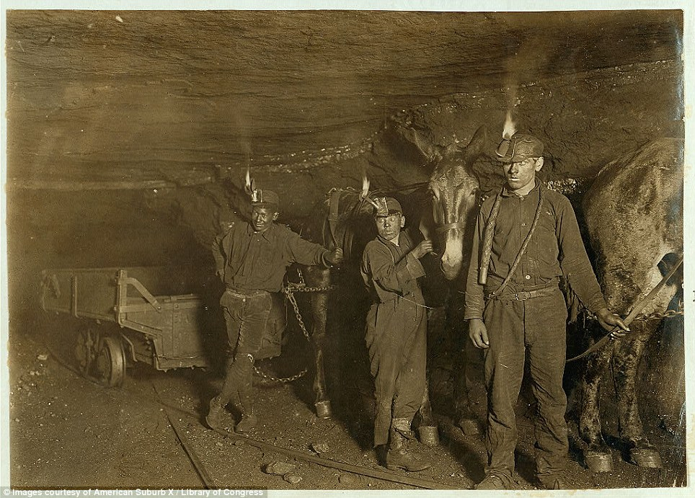
Social Reform – Child Labour
Provinces passed Child Labour laws and COMPULSORY Education Laws
By 1929 children excluded from mine and factory work in most provinces

Slide 5
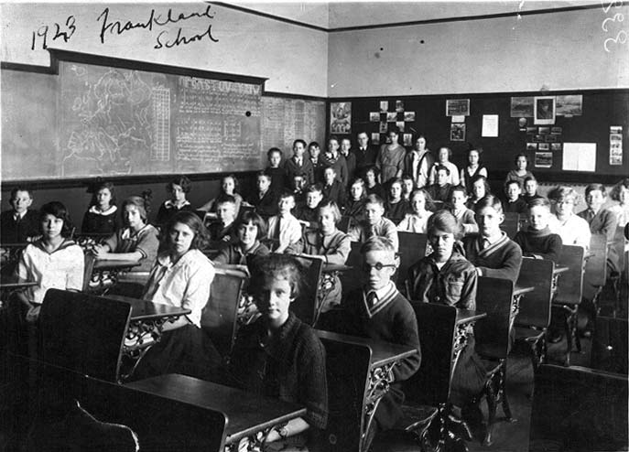
Social Reform Child Labour
In 1911, 63% of 14 year olds in school
In 1931, 83% of 14 year olds in school
Did not completely go away, especially during Great Depression

Slide 6
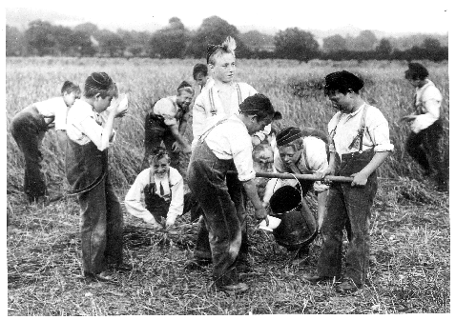
Social Reform – British Home Children
Late 1800s – early 1900s
~100,000 British orphans and children from poor families
Special immigration program
Sent to work (mostly on farms) until they were adults

Slide 7
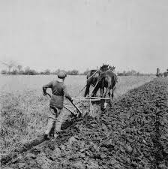
Social Reform – British Home Children
Some treated well
Some exploited
Worked long and hard for food, shelter, and a few $/month
Placements 7 years, little oversight

Slide 8
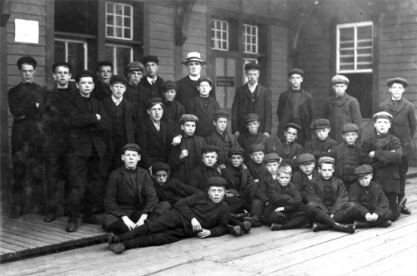
Social Reform – British Home Children
In 1925, federal government banned “juvenile immigrants” (>14)
Program ended by beginning of Depression

Slide 9
Silent Sustained Writing – 5 minutes
How does a country benefit from banning child labour? How do children benefit? In what circumstances might allowing some children to work be acceptable?

Slide 10
Innovations – Factory Assembly Lines

Slide 11
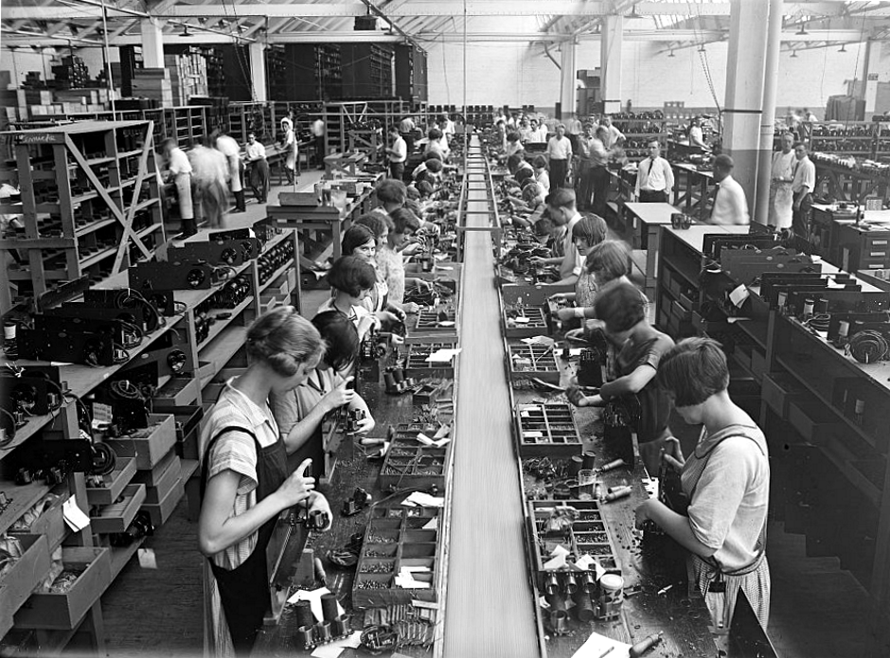
Innovations – Factory Assembly Lines
Quicker and cheaper if workers did only one job over and over
Rate of 1 car every 3 minutes
Made car ownership more accessible

Slide 12
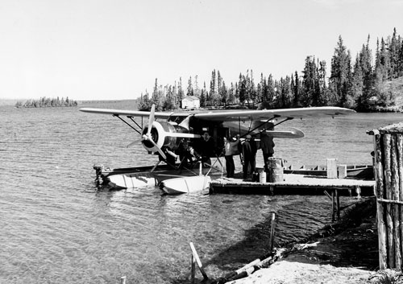
Innovations – Air Travel
Bush pilots – small aircraft to isolated areas
1936 Trans-Canada Airlines – Crown Corporation

Slide 13
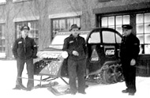
Innovations – Joseph-Armand Bombardier
As a teenager started looking at ways to make snow travel easier
Winter 1936-37 – 1st snowmobiles

Slide 14
Innovations - Communication
Coast to coast phone service in 1932 on Canadian Lines
In 1927, 13 of 100 Canadian homes had a phone
In 1945, 1 of 5 Canadian homes had a phone
Depression marketing focused on emergency and practical uses

Slide 15
Silent Sustained Writing – 5 minutes
Can parallels be drawn between telephone use in the 1920s and 1930s and the Internet today? Which technology do you think changed society more? Explain

Slide 16
Innovation - Tuberculosis
Deadly lung disease
Development of a vaccine
1st used on some Saskatchewan First Nations reserves
SUCCESS

Slide 17
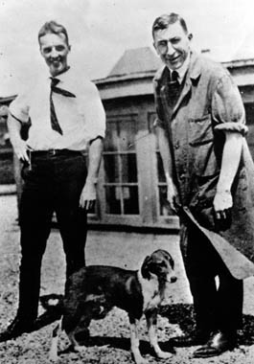
Innovation - Insulin
Dr.Frederick Banting
Insulin from cow fetuses lowered blood sugar in dogs with no pancreas
January 1922, Leonard Thompson (14 year old) 1st human test
SUCCESS
“One of the greatest achievements of modern medicine”

Slide 18
Innovation - Pablum
Malnutrition continued to be a problem (e.g. rickets)
1930 Dr. Frederick Tisdall, Dr. Theodore Drake, and Dr. Alan Brown developed a precooked cereal (flakey powder) with added vitamins and minerals
Pablum from latin pabulum (food)

Slide 19
Silent Sustained Writing – 5 minutes
The developers of both insulin and Pablum gave up control of their discoveries and allowed research institutions to benefit from the licensing revenues. In both cases, these revenues would have amounted to substantial amounts of money. Do you think that the same thing would happen if these developments occurred today? Why or why not?

