Slide 1
Explain the significance of Operation Jubilee with reference to the objectives and the results.
Step 1: Construct an outline for an essay answering the question
Step 2: Write an introductory paragraph for the essay (remember paragraphs are 5 sentences long)

Slide 2
Canada in Italy
July 1943 to February 1945

Slide 3
The Numbers
92,000 + Canadian troops in Italy
26,000 + casualties
5,300 + dead

Slide 5
Sicily
Prelude to a major invasion in Europe
Draw Nazi forces south
Americans, Canadians, and British soldiers succeeded in capturing Sicily in 38 days of hard fighting

Slide 6
Sicily
Difficult terrain requiring mule transportation for supplies
Secured an important airport for the invasion of Italian mainland

Slide 7
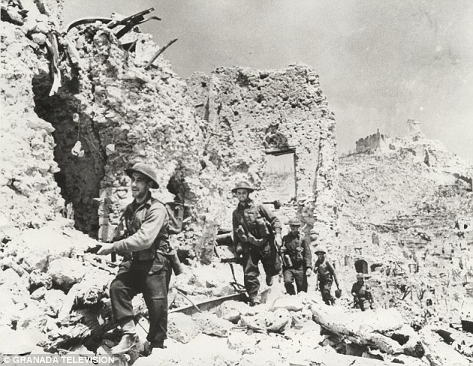

Slide 8
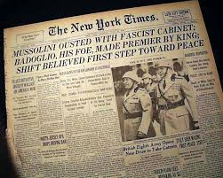
Italy Surrenders
Mussolini overthrown
Italy surrenders on September 3, 1943
Germany seized control

Slide 10
Southern Italy
By the end of September Allies controlled southern Italy
Germans had mostly withdrawn to defense positions along the narrow, mountainous central part of the peninsula

Slide 12
Ortona
20-28 December 1943
Only 1 way in – sea cliffs on the north and east and a deep ravine in the west
Canadians go in from the South

Slide 13
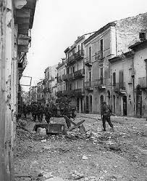

Slide 14
Ortona
Heavy fighting
“Mouse-holing”
1372 dead (25% of Canadians KIA in the Mediterranean)

Slide 18
Liberation of Rome
Canadian troops cleared the Liri Valley securing an important bridgehead on the road to Rome
American troops liberated Rome on 4 June 1944
Canadians sent to Europe to join the push to Berlin

Slide 19
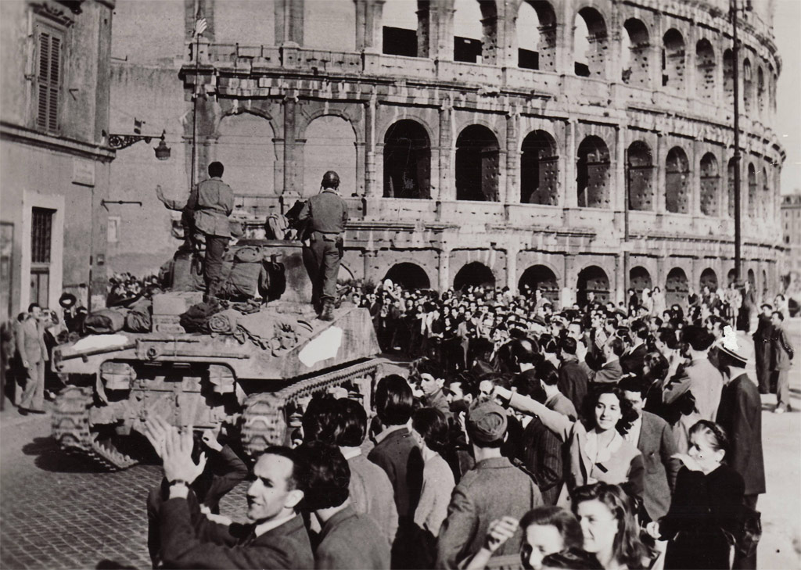

Slide 20
Devil’s Brigade (1st Special Service Force)
Joint Canadian and American Special Forces Unit of elite paratroopers
Took on the most dangerous and difficult assignments in Italy (and elsewhere)
Nicknamed Devil’s Brigade by German soldiers
Canadians made up 25% of the unit

Slide 21
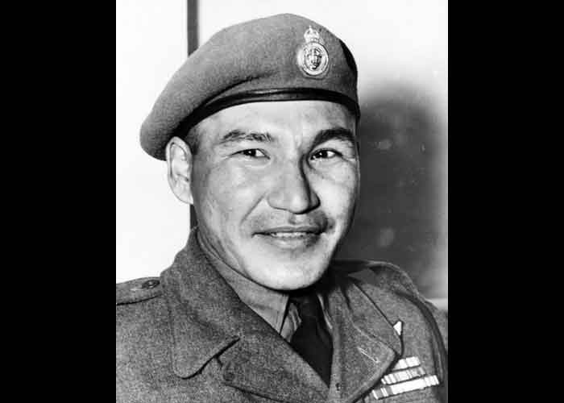
Sergeant Tommy Prince
Prince was in an abandoned farmhouse 200m from the German line
He was watching Germans and reporting back to his unit
Communication line was cut

Slide 22
Sergeant Tommy Prince
He dressed as a farmer, picked up a hoe, and walked into the field in full view of the Germans
Found the broken wire, pretending to tie his shoe, bent down and fixed it
He returned to the farmhouse and continued his work

Slide 23
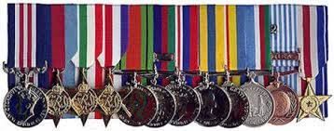
Sergeant Tommy Prince
Awarded Military Medal for bravery in the field (3rd highest bravery award)
Later received the Silver Star (American award for bravery) for his work in France (3rd highest bravery award)

