Slide 1
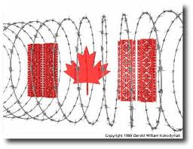
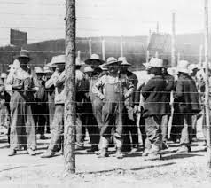
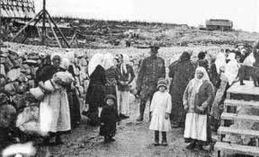
Internment in Canada
World War I

Slide 2
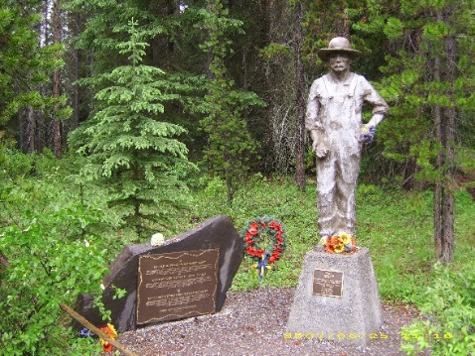
The Background
171,000 people in Canada were citizens of countries considered enemies of Canada
Many were second-generation and spoke English as their primary language
80,000 of them were forced to register with the police and report on a regular basis
More often if they were in the city, less if they lived in isolated places
Failure to report resulted in fines or imprisonment
8579 of them were confined as enemy aliens in 24 camps
81 women and 156 children are included in this number

Slide 3
What?
With NO evidence of disloyalty thousands of Canadians were imprisoned and forced to do heavy labour.
Tens of thousands of others were forced to register as “enemy aliens” and report to police.
Other state-sanctioned indignities: Disenfranchisement, restrictions on freedom of speech, movement and association, deportation, and confiscation of property

Slide 4
When?
Between 1914 – 1920
“I say unhesitatingly that every enemy alien who was interned during the war is today just as much as enemy as was during the war, and I demand of them Government that each and every alien in this dominion should be deported at the earliest opportunity… Cattle ships are good enough for them.”
Herbert S. Clements, MP (Kent West, Ontario) 24 Mar 1919.

Slide 5
Who?
The majority of people affected Ukrainians
Others included Germans, Poles, Italians, Bulgarians, Croatians, Serbians, Hungarians, Russians, Jews, Slovaks, Czechs, Armenians, Alevi Kurds, Turks, and Romanians.

Slide 6
Why?
Wartime anxiety, intolerance, and xenophobia
Xenophobia is a fear or hatred of strangers or foreigners

Slide 7
Where?
24 camps spread across Canada.
In BC camps were located:
Vernon
Nanaimo
Monashee-Mara Lake
Fernie-Morrissey
Edgewood
Revelstoke-Field-Otter

Slide 8
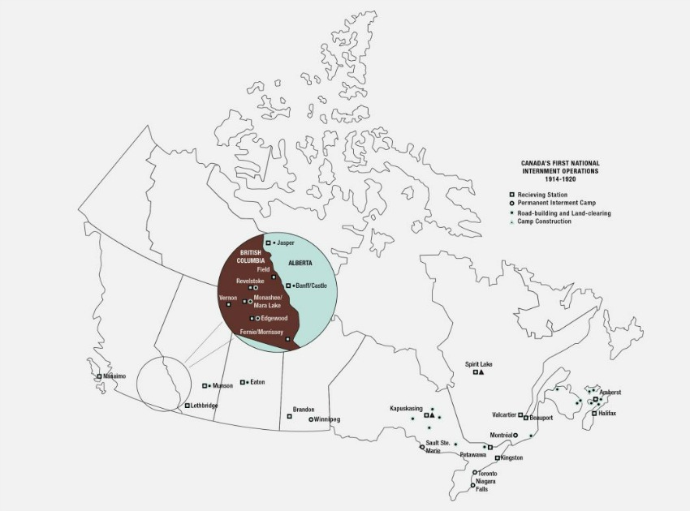
Map of Canadian Internment Camps

Slide 9
Significance
Example of legally sanctioned injustice
Civil rights of targeted Canadians denied without just cause, and entire communities subjected to indignity, abuse, and untold suffering
War Measures Act implement first during WWI provided the legal justification for the internment and was used later as the basis for interning Japanese Canadians during WWII
Exposed many of the anti-immigrant feelings of the general population of the day

Slide 10
Consequence
Direct Consequence – immediate result of an event
Indirect Consequence – caused by a direct consequence, subsequent events, or related decisions
Intended consequence – expected result
Unintended consequence – unexpected result

Slide 11
Web of Effects
Each group has 8 documents. Each person is therefore responsible for reading 2 of the documents. Read and take notes silently pay attention to cause and consequence.
Discuss the documents with your group. Share what you learned.
Fill out the web of effects worksheet independently.
Discuss your ideas with your group.
Share with the class

Slide 12
Assess the Impact
Psychological/emotional impact
Relating to the mental well-being or feelings and emotions of persons (motivation, feeling, awareness)
Social/cultural impact
Relating to the quality of the interactions with others and the ability to take part in daily events involving others

Slide 13
Economic
Relating to their ability to earn and enjoy a livelihood, and to the conditions in which they work
Political/legal
Relating to or concerned with their rights and freedoms as citizens and the involvement or influence on them by government and the legal system

Slide 14
Impact Assessment Report
Use your Web of Effects Sheet to fill out the Impact Assessment Report individually.
Ensure that you list at least 1 example for each and explain why you believe it goes in that category as well as how you decided the rating.
Discuss with you group.
Share with the class.

Slide 15
Wrap it up in your own words
Explain the overall impact of the internment on Canadians using evidence from psychological/emotional, social/cultural, economic, and political/legal consequences.
Write a short (150-250 words; less than 1 page double spaced) paragraph.

