Slide 1
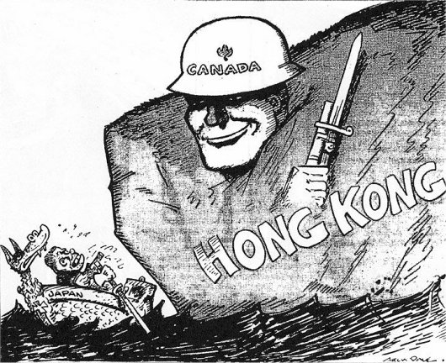

Slide 2
Battle of Hong Kong - Basic facts
8 hours after Pearl Harbour
1975 Canadian soldiers and 2 nurses stationed in Hong Kong
Allied forces greatly outnumbered
Fought to the bitter end

Slide 3
Battle of Hong Kong - Basic facts
On “Black Christmas” 1941 finally surrendered
1685 surviving Canadians went to Prisoner of War (POW) camps
260 died in the camps
Canadian government compensated veterans
Japan apologized for their treatment in 2011

Slide 4
Geneva Convention 1929 – Prisoners of War

Slide 5
Prisoners of War must be:
Shown respect at all times
Allowed to notify their next of kin and the International Red Cross of their capture.
Allowed to correspond with relatives and to receive relief parcels.
Given adequate food and clothing

Slide 6
Prisoners of War must be:
Provided with shelter equivalent to those of their captor's troops
Given medical care
Paid for any work they do
Sent home if seriously ill or wounded provided they agree not to resume active military duties.
Quickly released and sent home when the war is over.

Slide 7
Prisoners of War must not be:
Forced to give any information except their name, rank and number
Deprived of money or valuables without a receipt and guarantee they will be returned at the time of release
Given individual privileges other than on grounds of health, sex, age or military rank

Slide 8
Prisoners of War must not be:
Held in close confinement e.g. solitary confinement unless they have broken any laws. They can however have their freedom restricted for security reasons.
Be forced to do military or dangerous or unhealthy work.

Slide 9
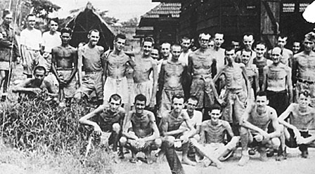

Slide 10
