Slide 1
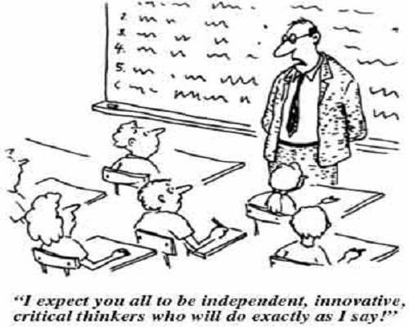
Historical Thinking
Framing the Discussions

Slide 2
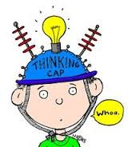
Critical Thinkers…
investigate, analyze, and interpret all available relevant evidence
make reasoned judgements
base judgements on clear criteria

Slide 3
Comparing The Past and History

Slide 4
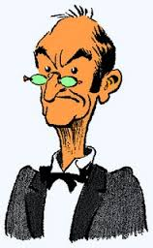
What the “experts” say…
What is the past?
The past consists of all things that ever existed, all the words that were uttered and all the deeds done.
The past no longer exists.
There’s no organized story to the past, only remnants have survived over time.
What is history then?
History can account for only a small portion of the past.
History is a way to remember the past through an organized story and analysis of the evidences of past events.
History is influenced by a selection of aspects of the past that are considered meaningful to us in the present.
HISTORY IS A CONSTRUCTION OF THE PAST

Slide 5
So what is a myth then?

Slide 6
What the experts say…
If history is a construction (a story) then how is different than a myth?
History
History is based on evidence.
Can be challenged and changed.
We want it to be challenged and revised.
Myth
Myth is based on belief or faith.
Can’t challenge or change a myth.
We don’t want to challenge or change it.

Slide 7
Critical Thinking Concepts
Ask critical questions:
Who chooses the stories that are told?
Why are certain stories told?
To whom are they told?
When are they told?
What do they mean?
Why are some stories not told?
Historical Significance, Cause and Consequence, Continuity and Change, Historical Perspective, Moral Judgement, and Evidence

Slide 8
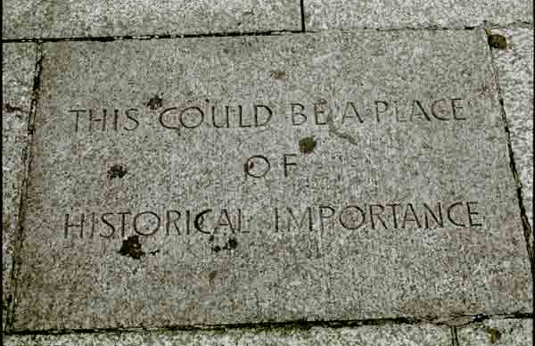
Historical Significance
The past includes everything but no one person can remember or learn it all.
Choices must be made and the writers of history are the ones who decide what is included. (Teachers decide what to teach, historians decide what to research, text book writers decide what to put in the book).
What is considered to be historically significant changes over time because people’s values change over time.
It can also depend on the point of view of the person.

Slide 9
Criteria
A standard (or rule) on which a judgement (or decision) may be based.
Think about what you how you decide what to wear in the morning…
Historians suggest that you may use either (or both) of the following criteria to judge historical significance
Does the event have serious, long-lasting consequences for many people
Does the event reveal or shed light on long-lasting or emerging issues
Keep this idea in the back of your mind as we go through the rest of the critical thinking concepts

Slide 10
What is Significant?
From the list on your table pick the 3 events that you think are the most significant.
Write down the reasons you selected these events
As a group come to a consensus on the 3 most significant events.
Explain your reasoning
Pick a speaker from the group
The class will debate what events were the most significant.

Slide 11
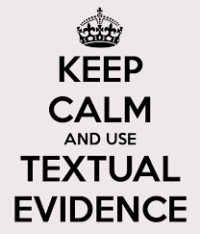
Information is not the same as evidence. To be evidence the information must be used to make an argument.
There is primary evidence
Original or first hand in terms of time and access to the event.
Natural records like fossils or tree rings
Constructed records like diaries or newspapers.
And there is secondary evidence
Constructed from other sources of information.
Prepared accounts like text books or films
Created accounts like replicas or reconstructions in a museum

Slide 12
Primary sources connect us to the past
Secondary sources are dependant on primary sources
Some secondary sources utilize other secondary sources which removes them even further from the historical event
Evidence can be drawn from accounts
Deliberate telling of the event or period
Eyewitness reports (primary) and textbooks (secondary)
Evidence can be drawn from historical traces
Remnants of the past
Ticket stubs (primary) and staged photographs (secondary)

Slide 13
Primary Accounts
Has the author provided a full and faithful report?
Was the author present for the event?
How might the author be influenced (context)?
Primary Traces
Is the item actually what it purports to be?
Is it genuine?

Slide 14
Secondary Accounts
Are the conclusions justifiable?
Are the sources used reliable?
Are relevant facts offered?
Is there adequate evidence?
Is there other information that might support a different conclusion?
Secondary Traces
Does it faithfully recreate the original document or object?
Are the choices made plausible given the available historical record?

Slide 15
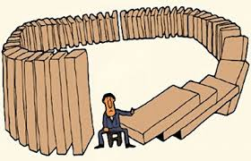
Cause and Consequence
Events very rarely have single or even only a few causes. Some causes may be more significant than others but that does not mean we should discount the other causes.
It is also important to remember recorded history may miss the stories of some groups which may contribute to historical change. Can you think of some of these under recognized groups?
Just because something happens before the event does not mean it causes the event.
Murder rates in California go up when ice cream sales go up. Eating ice cream therefore causes murder?

Slide 16
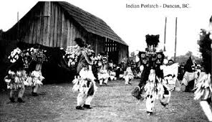
Identifying the immediate (direct) cause is important.
when scoring a goal in hockey, it is important to look the pass that precedes the shot on goal it is equally important to think about the underlying causes that are more long term (the hours of practice that came before the game).
It is equally important to think about the underlying causes which may be more long term.
the hours of practice that came before the game.
Actions may have unintended consequences
In BC the Potlatch (Traditional gathering of many Coastal BC Aboriginal groups) was banned in (arguably) an attempt to forcibly assimilate First Nations peoples into European colonial culture but actually pushed the many First Nations away from it.

Slide 17
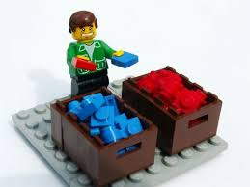
Sort it out
Read through the Sorting immediate and underlying causes sheet
As a team sort each statement into either an immediate or a underlying cause.
Explain your reasoning.
Elect a speaker from your team to speak during a class discussion.

Slide 18
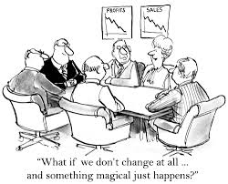
Continuity and Change
Change is a continuous process, not a series of separate events.
Circumstances can change abruptly at certain time.
It is therefore important to identify turning points.
Change does not always mean progress.
You need to develop a chronology of events to understanding continuity and change.
The order of events matters.
Breaking history into specifically defined periods can help organize understanding.
Think “roaring twenties” or “turbulent thirties”

Slide 19
Look at the 2 Photos
The photos show Hastings Street in Vancouver in 1925 and 2012.
What is the same?
What is different?
What is one thing that is likely to still be there in 10 years?
What is one thing that is likely to be gone there in 10 years?
Source: https://www.flickr.com/photos/entheos_fog/8470584056/

Slide 20
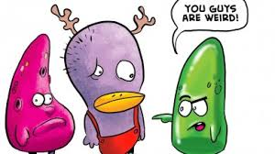
Consider this….
There is a cultural group that:
Made baby diapers out of moss
Plays soccer at 3am
Used fish as runners on a sled
Think: What do you think about this cultural group?
Pair: What does your partner think about this cultural group?
Share: What does the class think this about this cultural group?

Slide 21
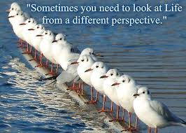
There is a cultural group that:
Made baby diapers out of moss
Moss was free, biodegradable, widely available, and had hygienic properties.
Plays soccer at 3am
The winter is long and almost entirely too dark, so they make use of the long (endless) daylight in the summer.
Used fish as runners on a sled
Cheap and replaceable source of material.

Slide 22
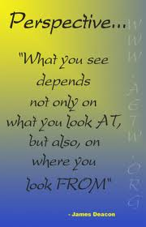
Historical Perspective
People in the past were different from the people today in a variety of ways.
To take a historical perspective means you put yourself in the shoes of someone in the past.
This does not mean you must agree with the actions or attitudes of the past but it does mean you should try to understand them.
Looking at primary documents can help you do this.
Do not impose your own meanings on what you see or hear.
There was a diversity (of opinions) in the past, the same as there is today and therefore you should try to understand a variety of perspectives in order to understand the past.

Slide 23
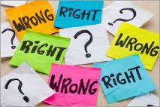
The Ethical Dimension
Be aware of using a contemporary lens to judge events, and people in the past.
Do not ignore or whitewash discrimination, crimes, or events of the past but treat them ethically by providing the context for the period in which they took place.
Avoid making ethical judgements outside of context.
When evaluating historical accounts be aware of both implicit and explicit value statements.
Cause is the not the same as responsibility.

Slide 24
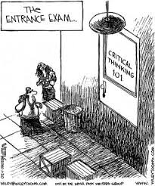
What does this have to do with this course?
Throughout this course you are going to be asked to challenge historical accounts.
Throughout this course you are going to be asked to assess historical accounts.
Throughout this course you are going to be asked to become historians.

Slide 25
Sources
Images are sourced from Google Images
Colyer, J., Cecillon, J., Draper, G., and Hoogeveen, M. (2010). Creating Canada: A history – 1914 to the present. Toronto: McGraw-Hill Ryerson Ltd.
Denos, M. and Case, R. (2006). Teaching about Historical Thinking. Vancouver: Critical Thinking Consortium.

