Slide 1
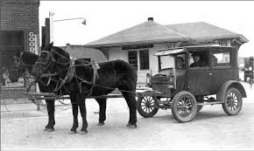
Consequences of the Great Depression in Canada

Slide 2
Factories closed
Unemployment reached 27% at the height in 1933

Slide 3
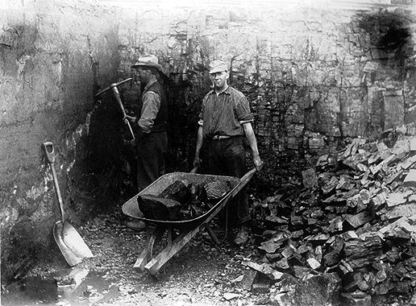
Resource Based Economy

Slide 5
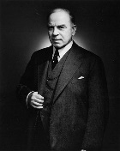
Mackenzie King versus Bennett

Slide 6
Restricting Immigration

Slide 8
