Slide 1
Some Terms to Know
The Business Cycle

Slide 2
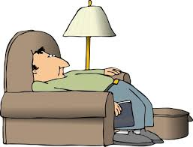
Slump
Reduction in demand = slower output
Confidence may begin to suffer

Slide 3
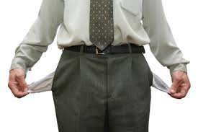
Recession
Period of slow economic growth
Output may decrease
Firms may lose confidence = reduce investment
Individuals save not spend

Slide 4
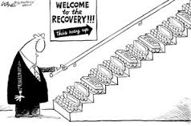
Recovery
Between recession and a boom

Slide 5
Boom
A period of fast economic growth.
Increased demand = output high
Low unemployment
Increased investment = business confidence
Consumer confidence = extra spending

Slide 6
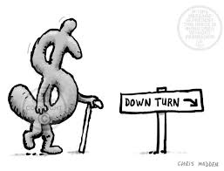
Depression
Severe recession
Lasts longer

Slide 7
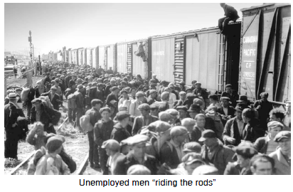
Unemployed men “riding the rails”

Slide 8
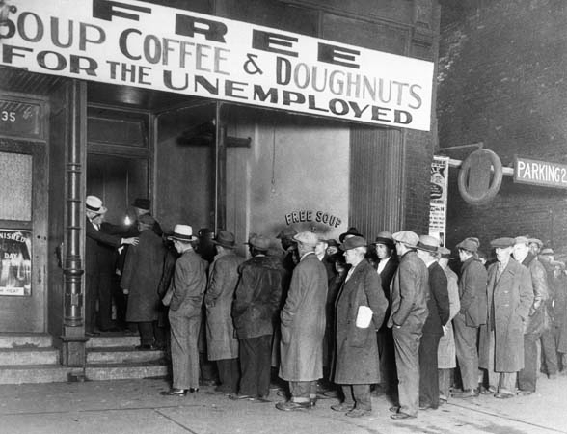

Slide 9
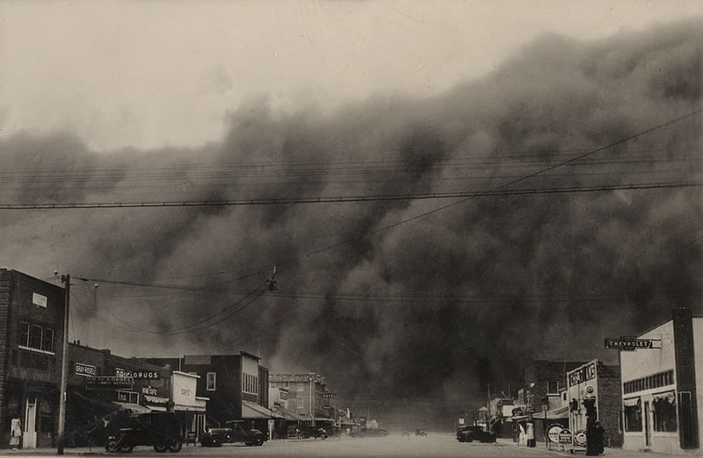

Slide 10
