Slide 1
Canadian Autonomy

Slide 2
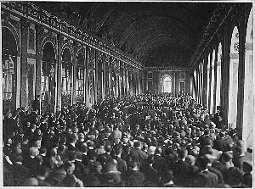
Paris Peace Conference 1919
Canada had its own seat during the Paris Peace Conference and signed the Treaty of Versailles independently

Slide 3
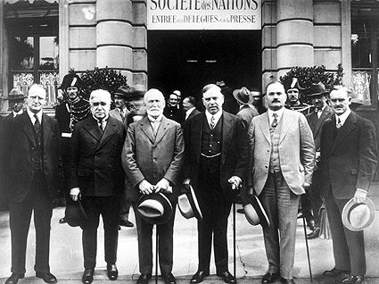
League of Nations 1920
Independent membership in the new international organization

Slide 4
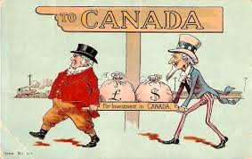
Investment in Canada 1920s
US investment in Canada increases
US investment in Canadian resource companies (these resources were then shipped out of Canada to the US)

Slide 5
Branch Plants 1920s
US companies set up branch plants in Canada which were American owned and controlled

Slide 6
Group of Seven 1920s and 1930s
Distinctly Canadian art
Emerged at the same time as increasing US influence on Canadian culture

Slide 7
Chanak Crisis 1922
Britain requests Canadian support to defend British Port against Turkish forces
PM Mackenzie King stated that Canadian Parliament would decide
Britain can no longer assume Canada will automatically answer the call

Slide 8
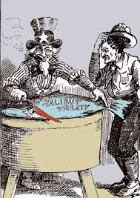
Halibut Treaty 1923
Canadian-American treaty regulating the Halibut fishery in the Northern Pacific
First treaty signed by Canada without the presence of a British official

Slide 9
King-Byng Crisis 1926
PM Mackenzie King asked Governor General Julien Byng to dissolve Parliament while a motion of no confidence was being debated
Byng refused, King resigned

Slide 10
A couple of months later Parliament was dissolved and an election was called
King ran on the constitutional issue, where a British GG interfered with the rights of Canadians to govern themselves
King and the Liberals won

Slide 11
Balfour Report 1926
Imperial Conference acknowledged that Canada was becoming less subordinate to Britain.
The Balfour Report recognized that British dominions, including Canada, were autonomous and the GG was only a representative of the monarch

Slide 12
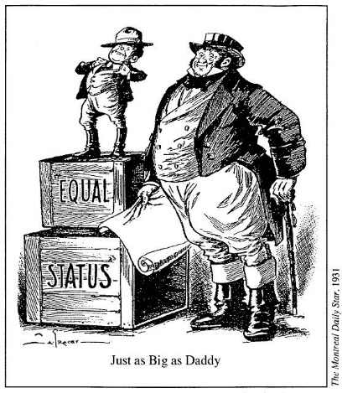
Statute of Westminster 1931
Recognized the details of the Balfour Report
Canada was now able to make their own foreign policy
Canada began to establish Canadian embassies around the world

Slide 13
Hockey Night in Canada
First broadcast in 1931 with play by play with Foster Hewitt on the radio
Moved to television in 1952

Slide 14
Canadian Broadcast Company 1936
Public radio created by the federal government
Called the CRBC (Canadian Radio Broadcasting Commission)
Later reorganized into the Canadian Broadcast Company
Canadian based programing in French and English

Slide 15
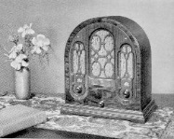
Radio 1930s
During the depression radio was very popular
By the end of the 1930s, 75% of Canadian homes had one
Canadians often listened to US syndicated shows, partly because they were more sophisticated and party because many local radio shows bought by American companies

