Slide 1
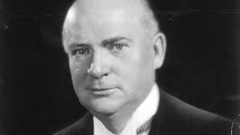
Prime Minister R.B. Bennett
1930 - 1935

Slide 2
Tariffs
Believed that TARIFFS were necessary for 2 reasons
To keep Canada independent of the US
To create markets for Canadian producers
TARIFF revision – steeply upward was instituted

Slide 3
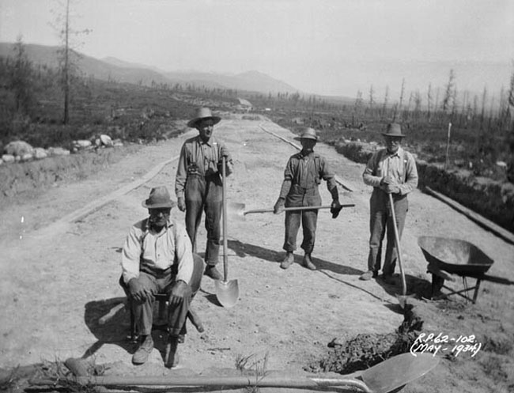
Unemployment Relief Act
$20m for public works

Slide 4
Imperial Conference
Hoped for reciprocal preference in trade
“I offer to the Mother Country and to all the other parts of the Empire, a preference in the Canadian market in exchange for a like preference in theirs.”

Slide 5
More Tariffs
Wheat prices are dropping
Drought continues
Tariffs increased again in 1931

Slide 6
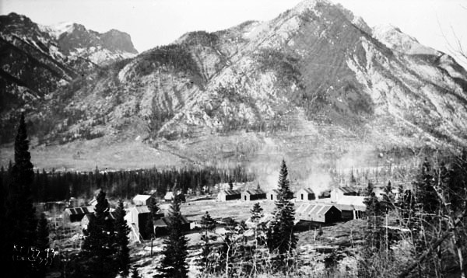
Unemployment and Farm Relief Act
More public works money
Direct relief
Similar acts passed in each consecutive year until 1935

Slide 7
Wheat
Looking for ways to market the wheat crop
Established the Canadian Wheat Board in 1935

Slide 8
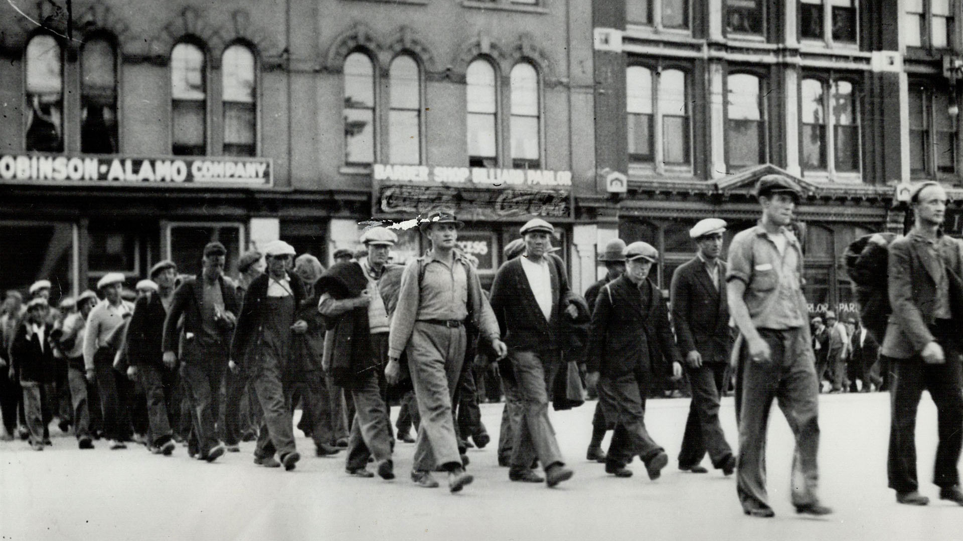
It gets worse
The government’s deficit was $150m
1.5m (+) people dependent on direct relief
Unemployment Relief Camps (single men) becoming hotbeds of discontent

Slide 9
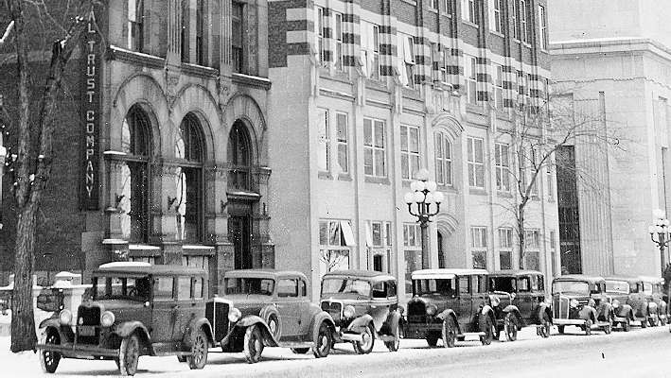
Banking
US banks locking their doors
1934 establishment of the Bank of Canada

Slide 10
Acts of Government
Farmers’ Creditors Arrangement Act (1934)
Allow families to remain on farms
Natural Products Marketing Act
Orderly marketing in the hope of obtaining better prices
Public Works Construction Act
$40m getting the unemployed back to work

Slide 11
Bennett’s New Deal
Federal government intervention to achieve social and economic reform
Employment and Social Insurance Act
Minimum Wage
Eight-hour days
48-hour weeks

Slide 12
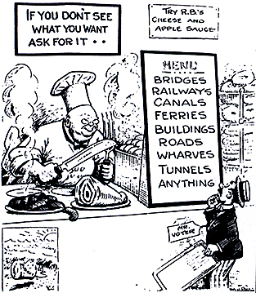
Long Held Beliefs
Old Age Pensions
Unemployment insurance
Labour Unions

Slide 13
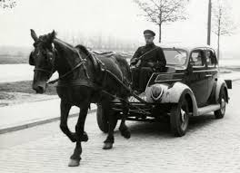
Discontent
Bennett Barnyard
Bennett Buggies
Bennett Blankets
Bennett Soup

