Slide 1
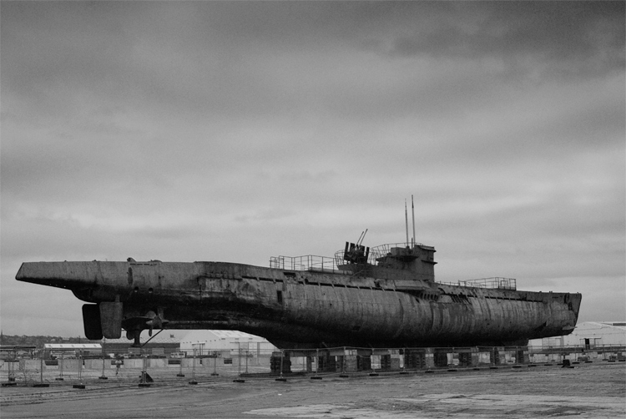
Battle in the Atlantic
The longest battle of the war

Slide 2
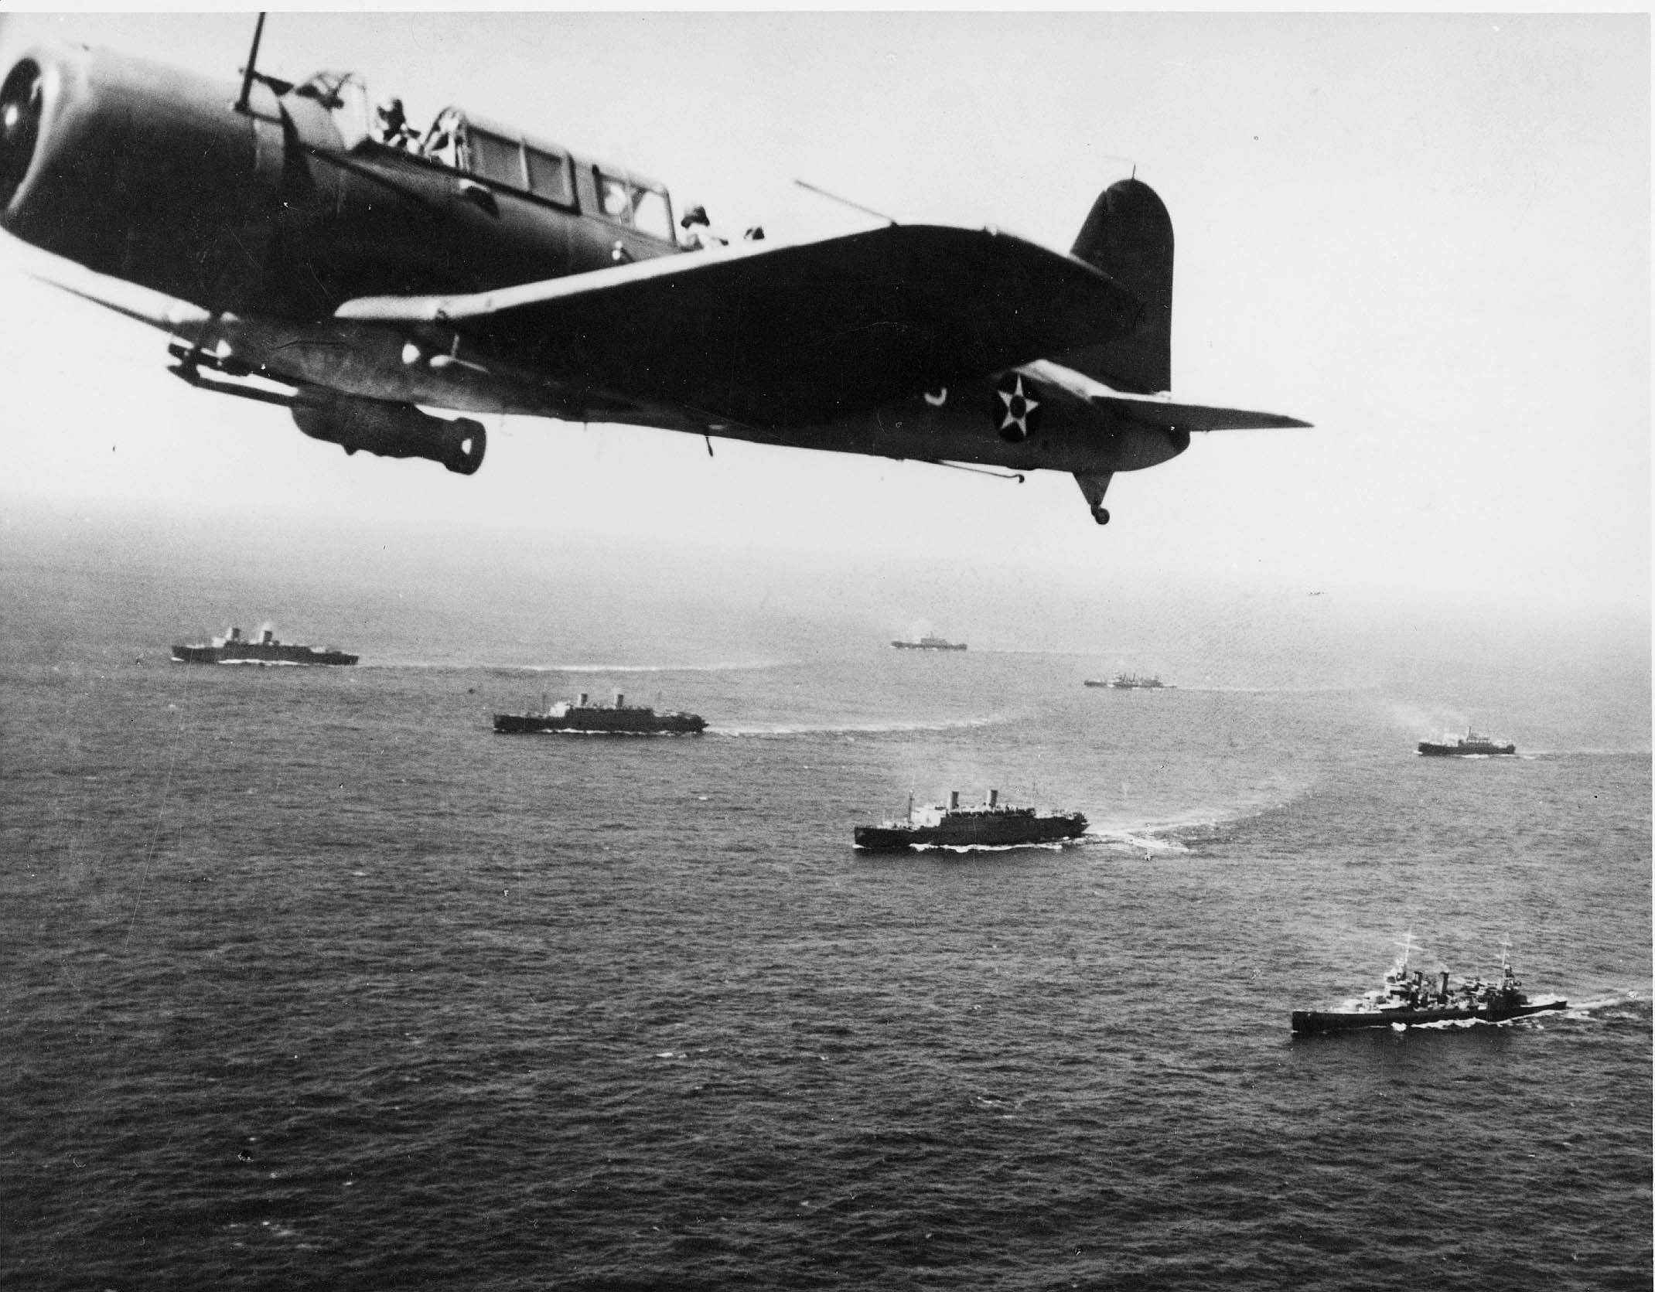
Supply Lines
Britain relied on supplies and reinforcements from Canada (and US)
Germany wanted to cut this supply line off
U-Boats were used to hunt down and attack

Slide 3
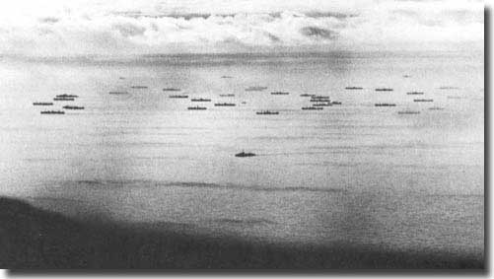
The Convoy System
Convoy system was set up like WW1
Merchant ships surrounded by military vessels
Air support from both sides

Slide 4
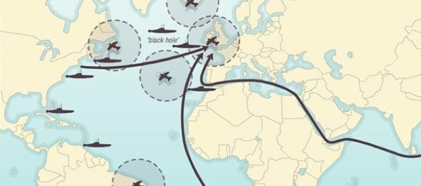
The Gap
Ships most vulnerable in the “Black Gap”
Planes could not reach so no air cover

Slide 5
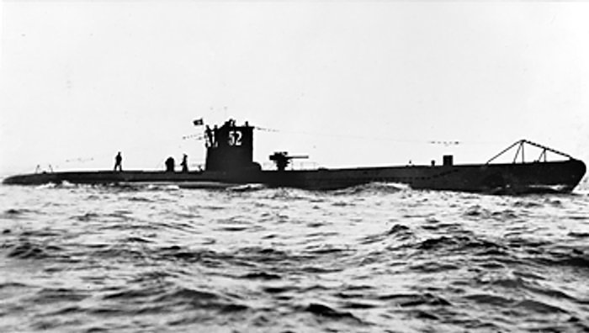
Wolf Packs
U-Boats traveled in large groups called Wolf Packs

Slide 6
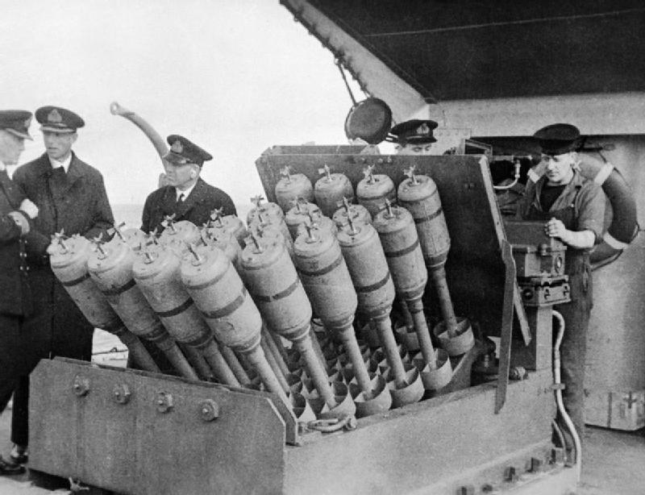
New Technologies
Long range Lancaster planes
Hedgehog’s
Improved submarine detection/tracking

Slide 7
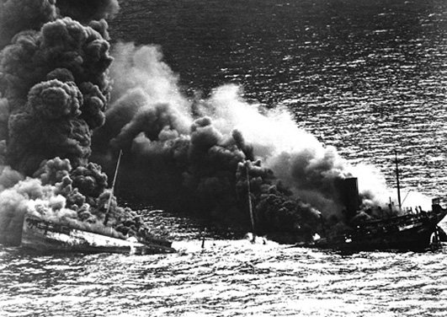
The Numbers
2000 Canadian troops
1600 Canadian and Newfoundland merchant mariners

Slide 8
More Numbers
At the start of the war Canadian Navy was 13 ships and 13,000 members
At the end it had the 4th largest Navy in the world
375 ships and 110,000 members

Slide 9
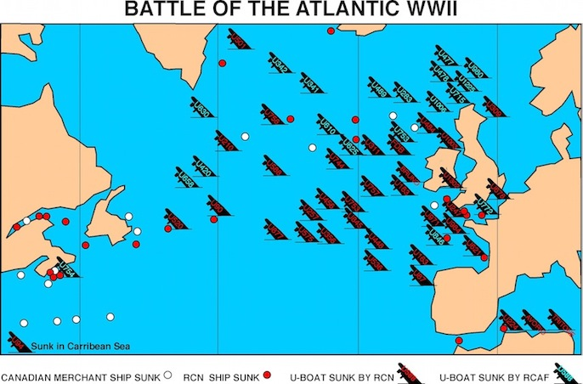

Slide 10
Churchill’s Memoir
“The Battle of the Atlantic was the dominating factor through the war. Never for one moment could we forget that everything happening elsewhere, on land, at sea, or in the air, depended ultimately on its outcome, and amid all other cares we viewed its changing fortunes day by day with hope and apprehension.”

Slide 11
Write for 3 minutes
Should Canadians be proud of Canada’s contribution to the Allied effort in the early years of the war? Why or why not?
Choose an example that supports your response.

